Slide 1
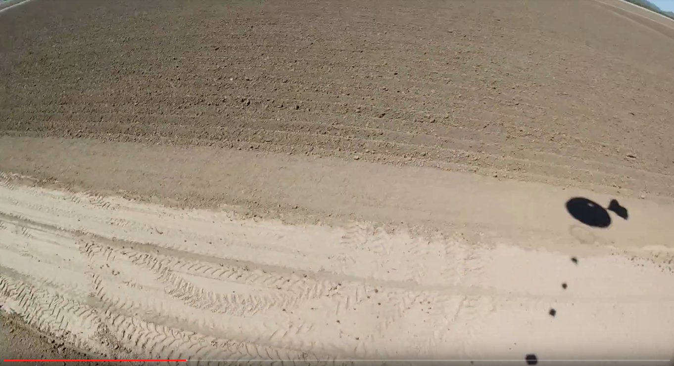



ASCEND 2017 PAYLOAD DESIGN PROJECT ECE 294-GLENDALE COMMUNITY COLLEGE WEBSITE: Team2.AZEngineeringEducation.com

Slide 2

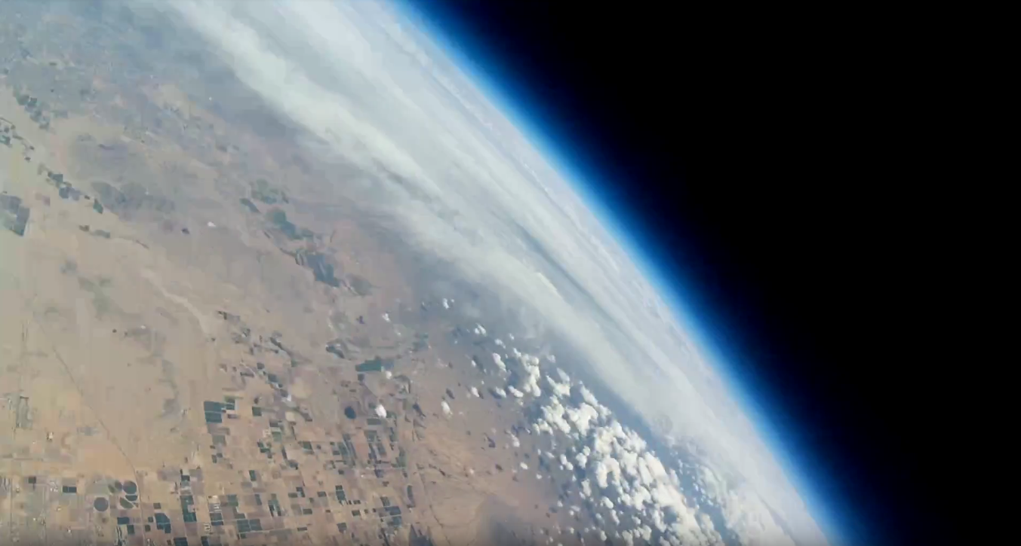
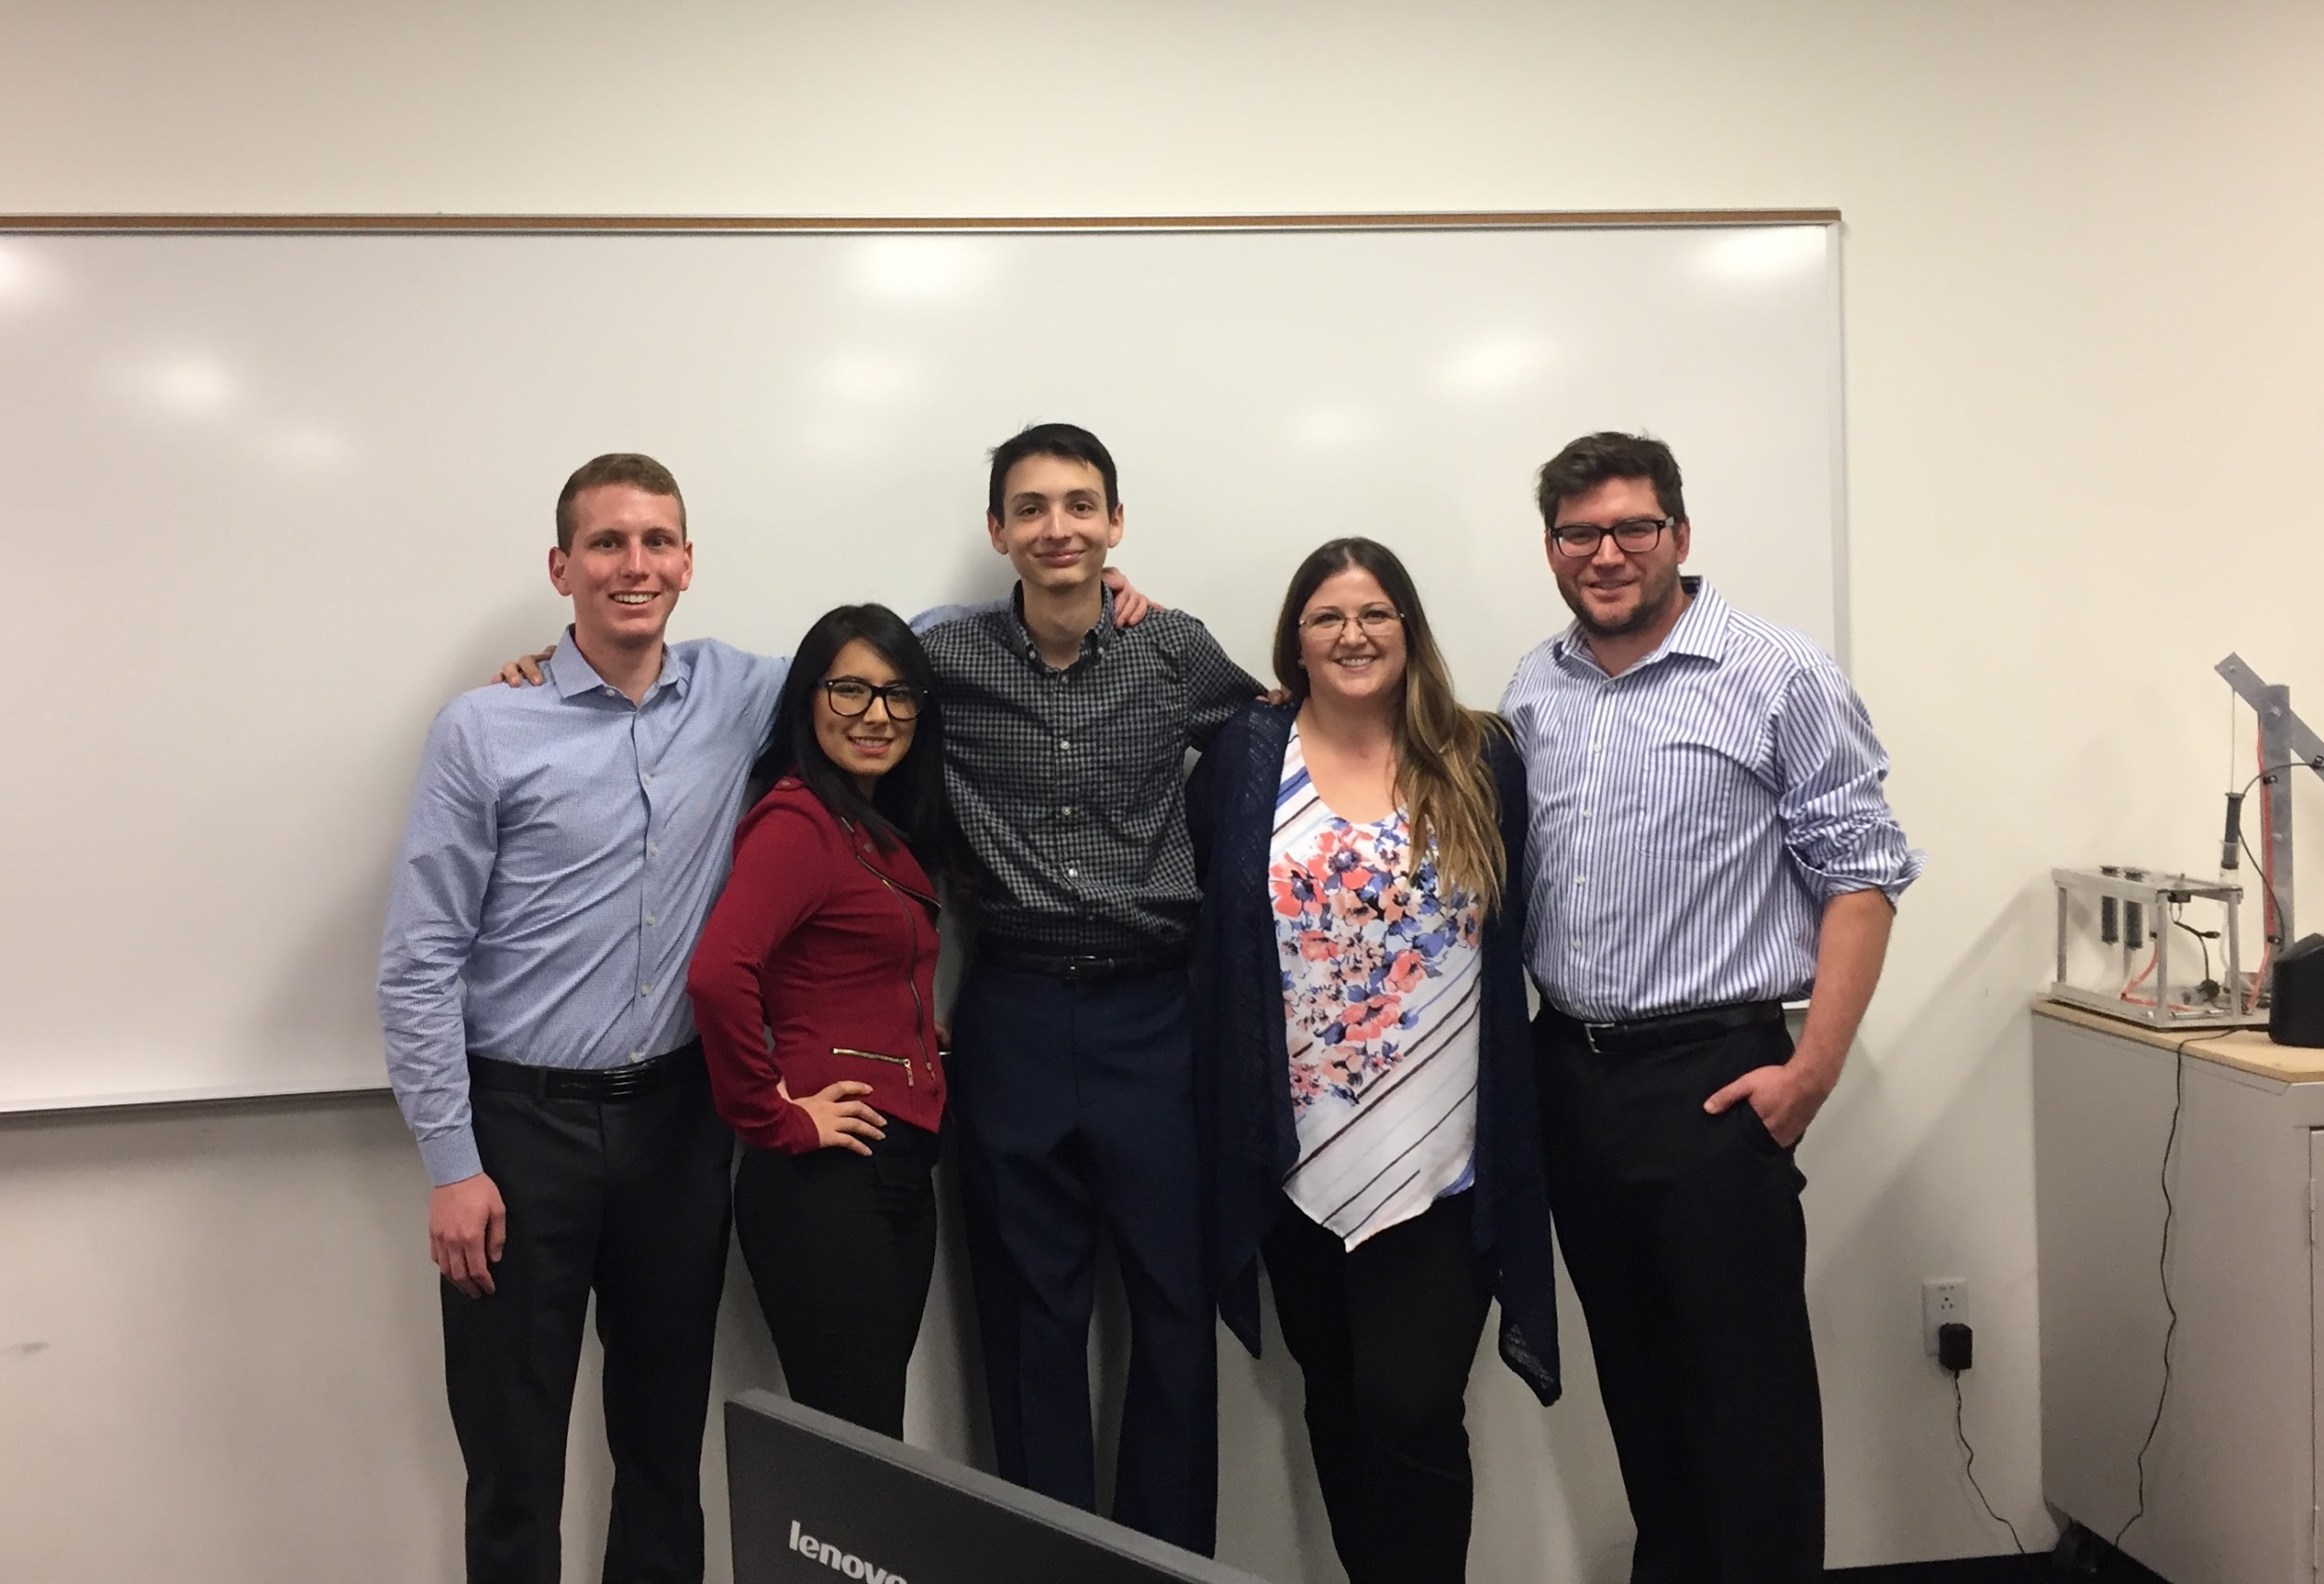
CHANCE MARTINEZ-DROEG, LEONOR AMAYA, HENRY MEYERS, ANESA THIELE, JAMES COOK

Slide 3
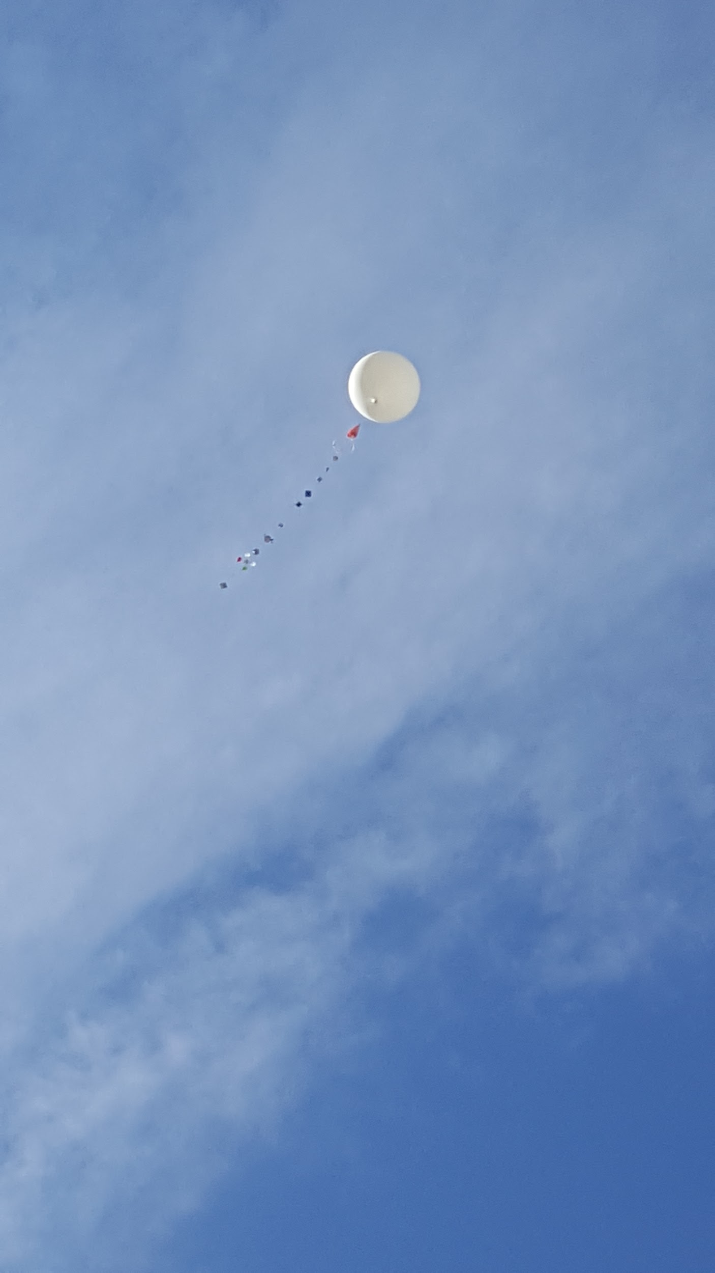
Overview
Project Goals
System Block Diagram
Sensors and Data
Camera
GPS
Processor and Coding
Enclosure
Flight

Slide 4
Goals
Learn about the engineering design process
Design, Build, Test, and Launch a working payload within the constraints given
Must weigh less than 1.5 lbs
Must cost less than $400
Must use certain default sensors
Analyze the data and make conclusions based on our findings
Present and compare our data to our peers
Assess our successes and our failures to aid future students
Notes:
check this out http://team2.azengineeringeducation.com/mission.html

Slide 5
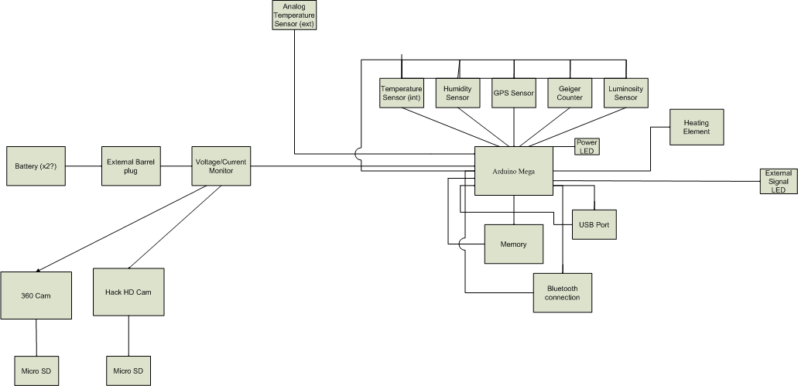
System Block Diagram

Slide 6
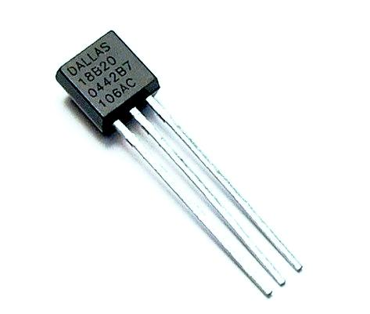
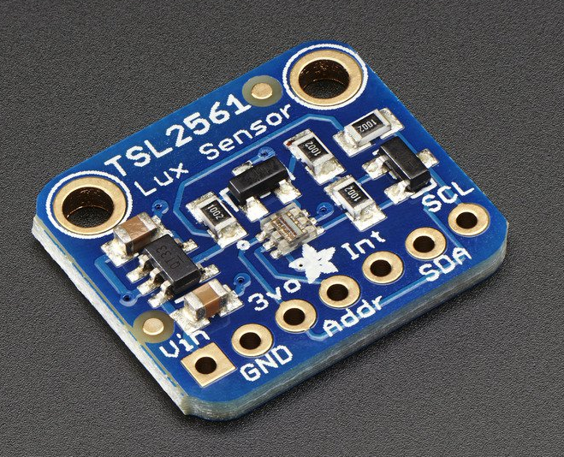
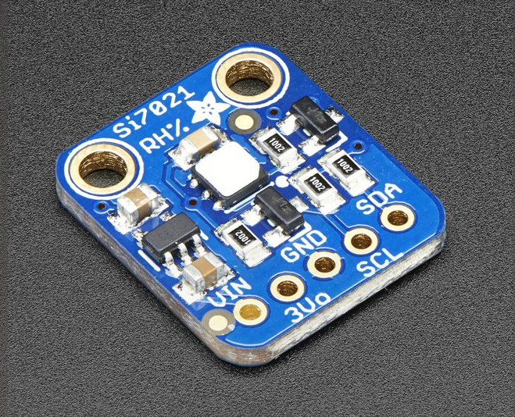
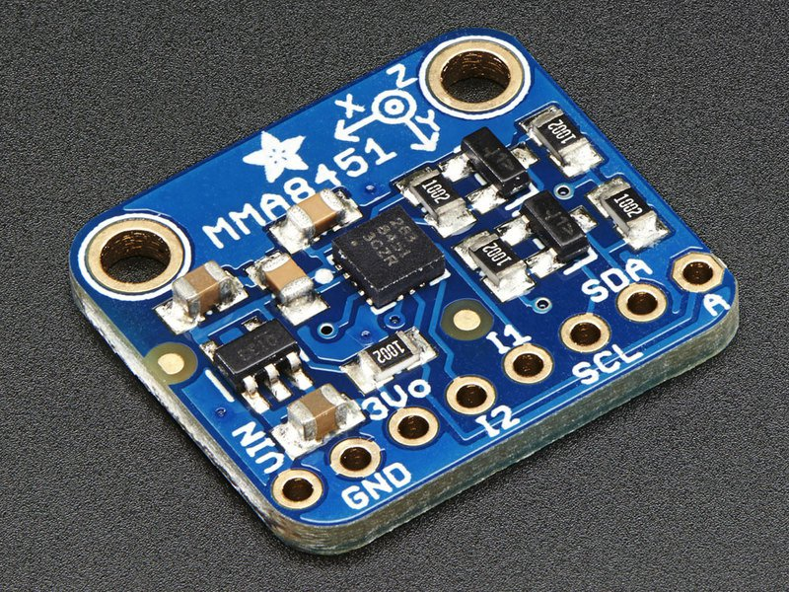

Sensors
Adafruit TSL2561 Digital Luminosity/Lux/Light Sensor
Adafruit Si7021 Temperature & Humidity Sensor
Adafruit MMA8451 Accelerometer
Honeywell ASDX Analogue Pressure Sensor
Dallas Semiconductor Temperature Sensor

Slide 7
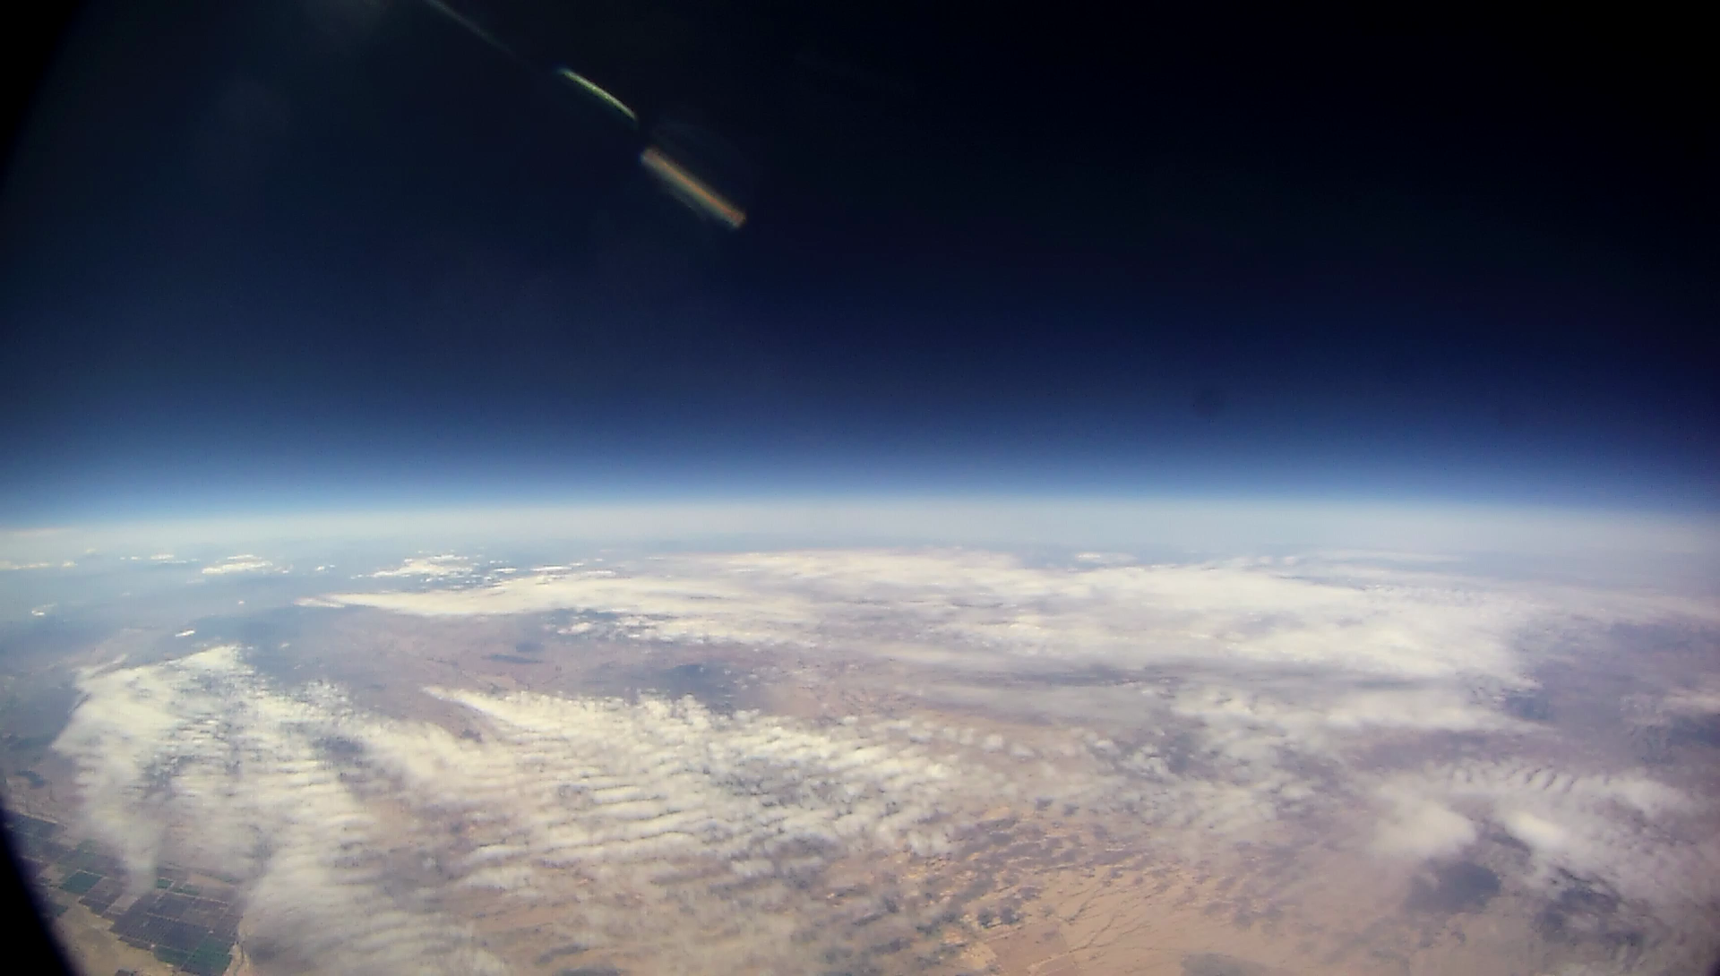
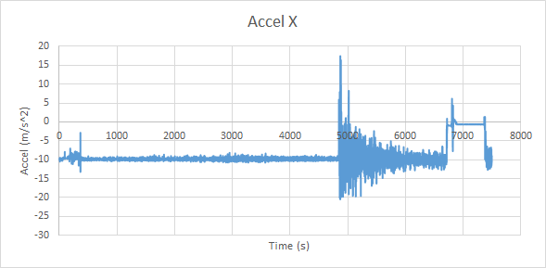
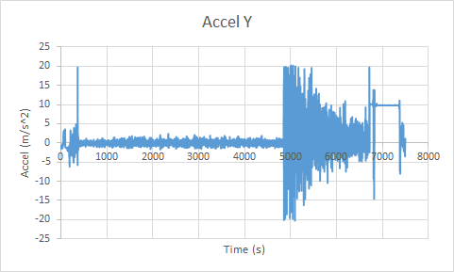
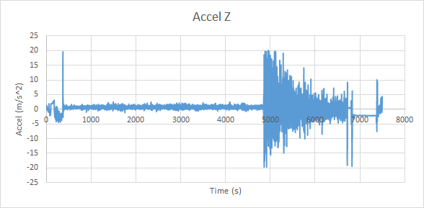
Accelerometer Data

Slide 8
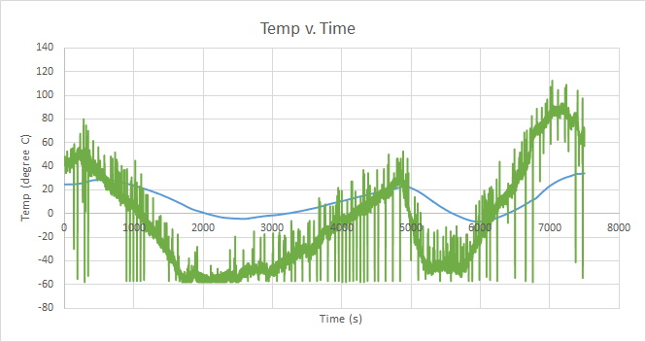
Temperature Sensor Data

Slide 9
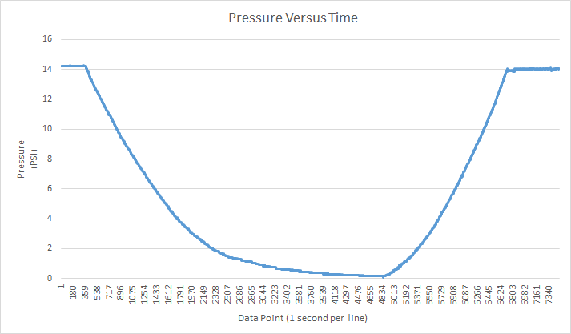
Pressure Data
Notes:
have it in units on the bottom

Slide 10
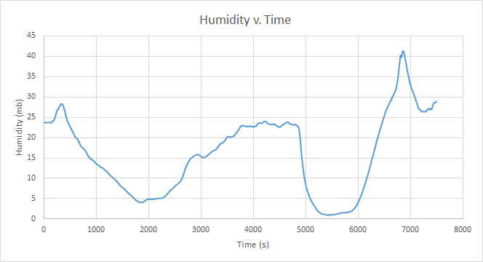
Humidity Sensor Data

Slide 11
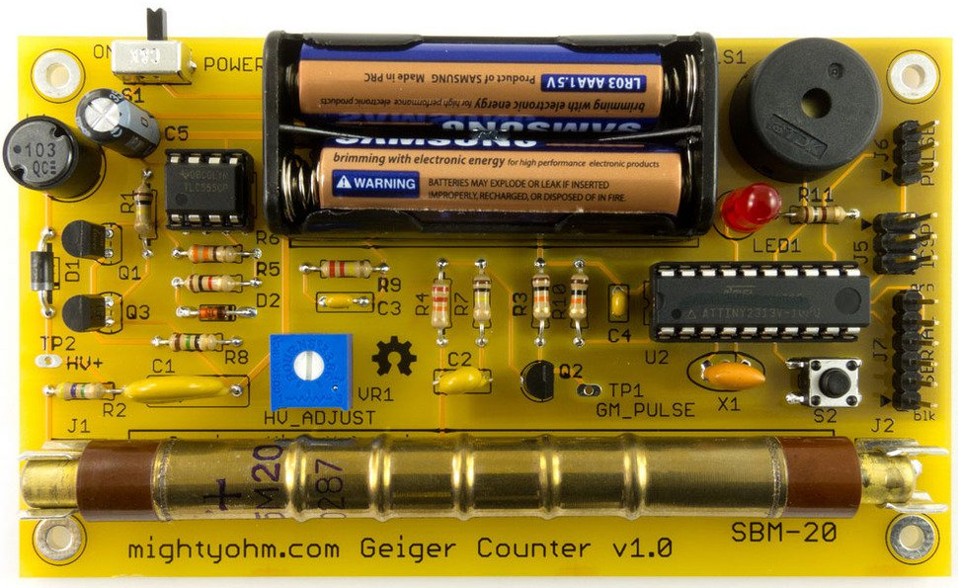
Geiger Counter -Radiation Sensor

Slide 12
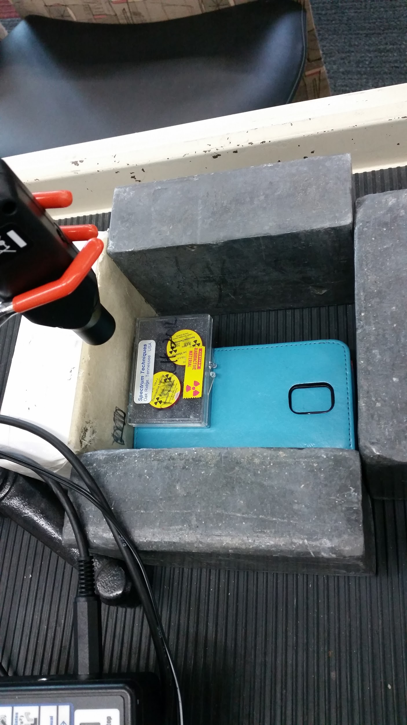
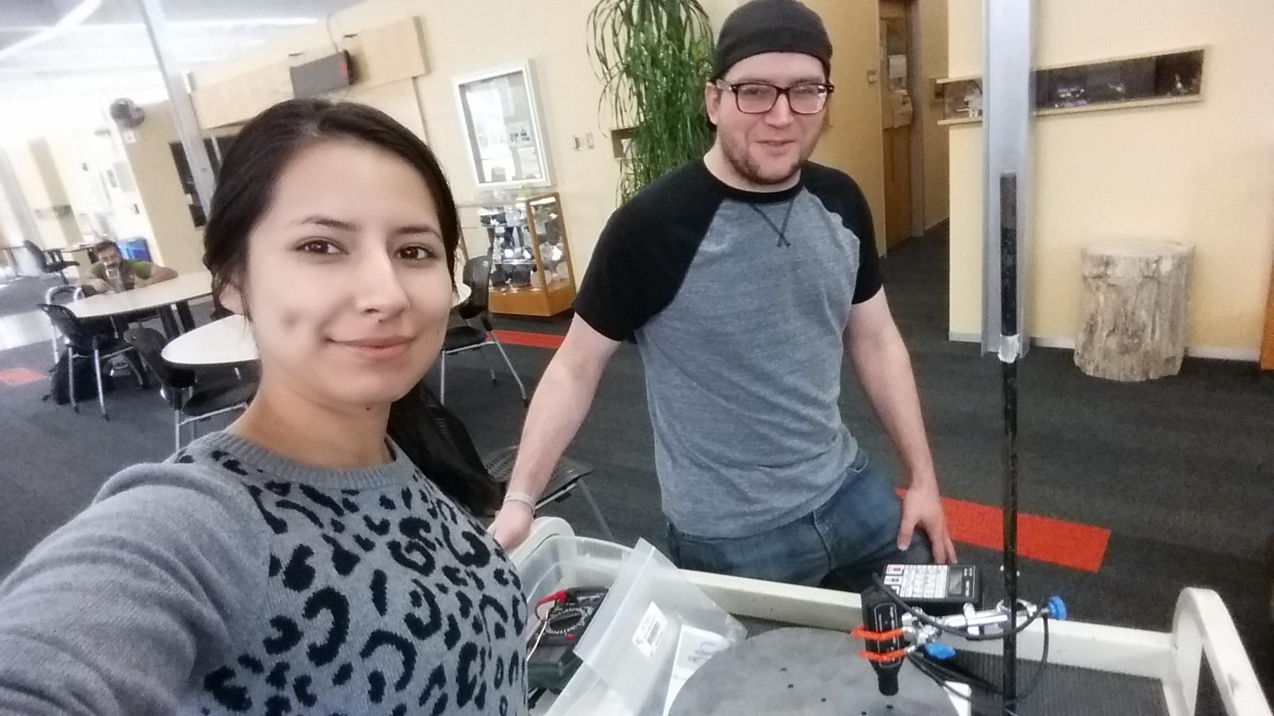
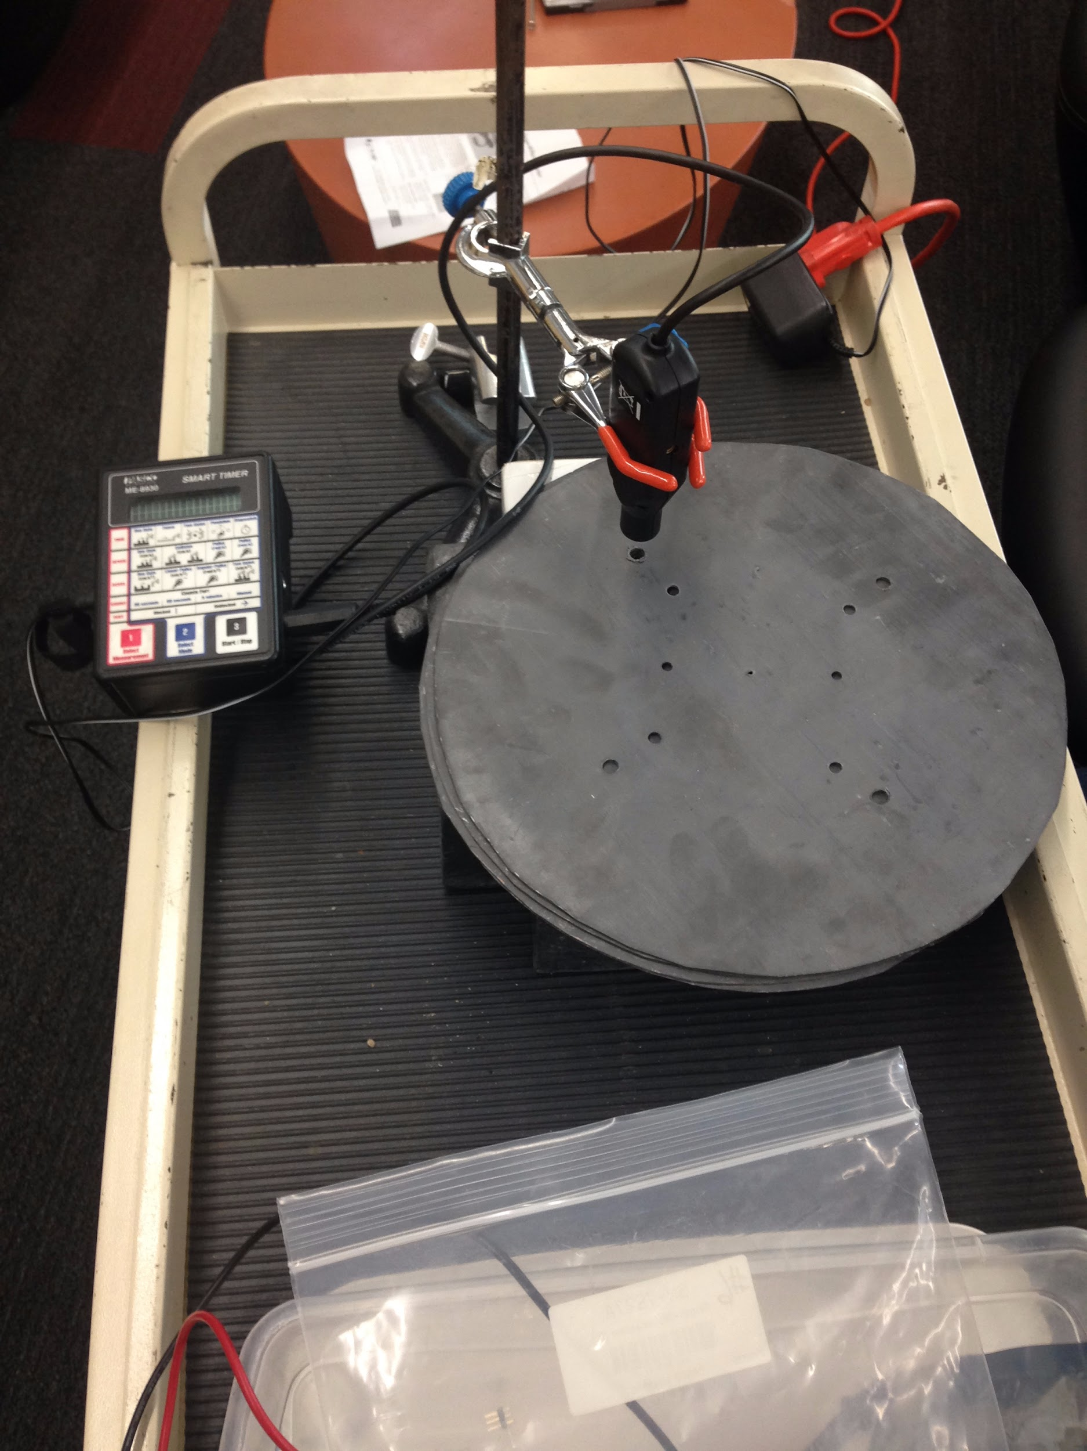
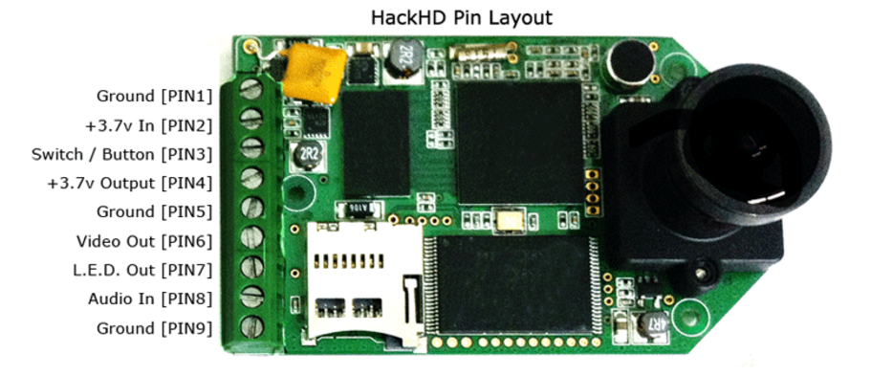
Calibration of Geiger Counter

Slide 13

Geiger Counter -Data

Slide 14
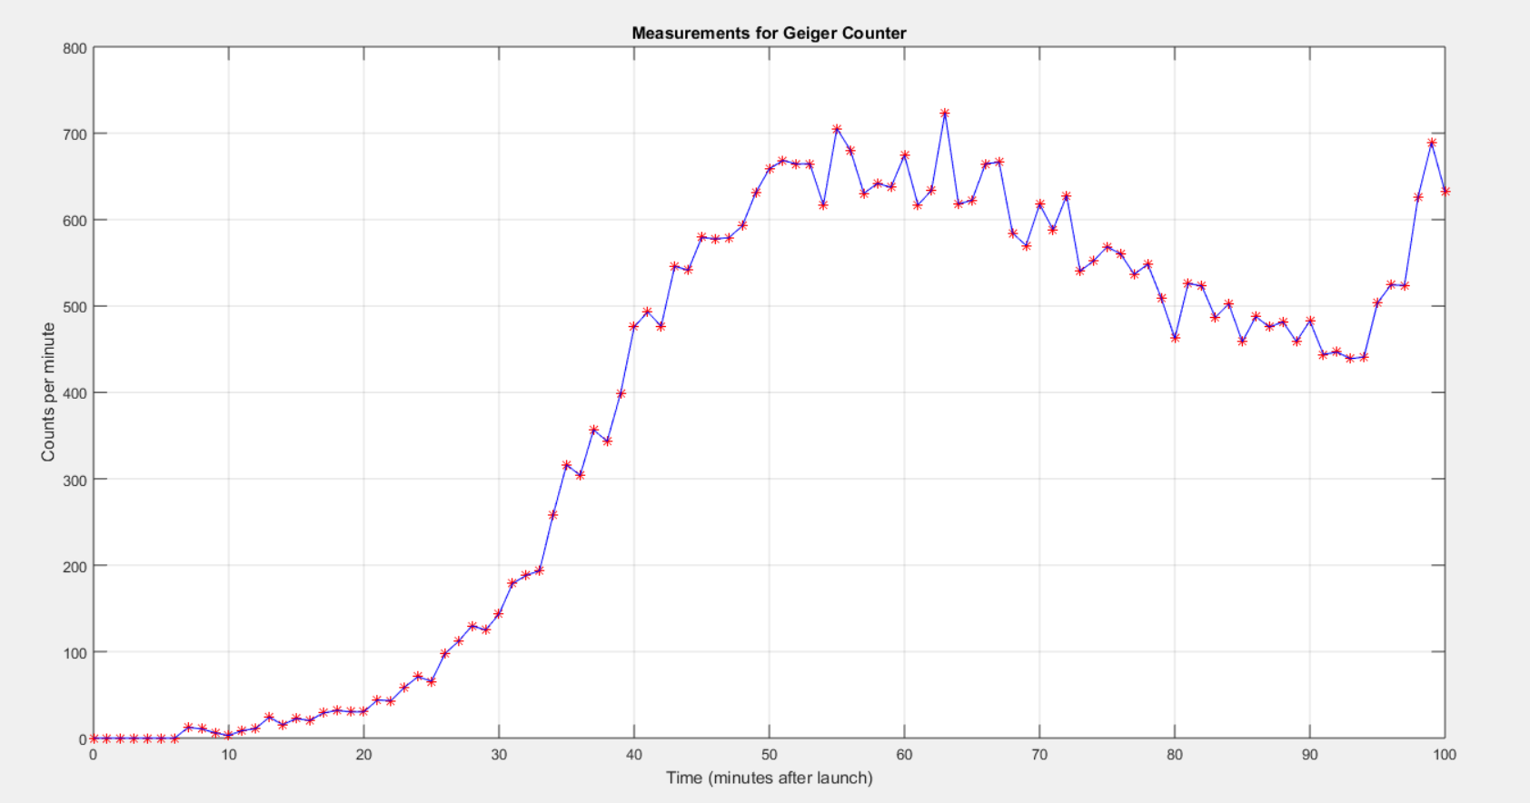
Geiger Counter -Data

Slide 15
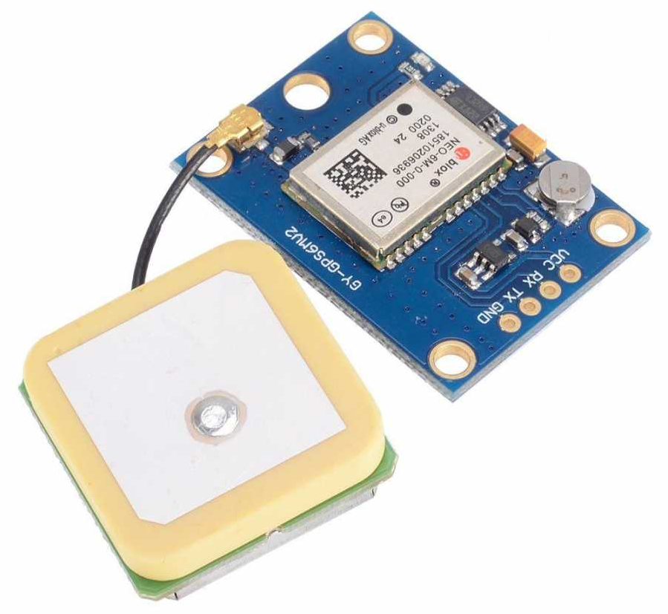
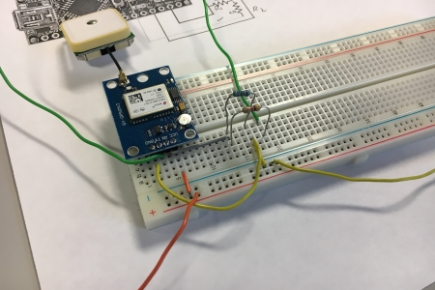
GPS- NEO6MV2

Slide 16
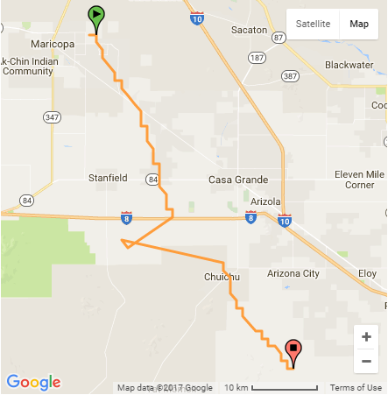
GPS Data on Google Maps
Saved latitude and longitude data to excel file.
Then uploaded the excel file to GPSVisualizer.com

Slide 17
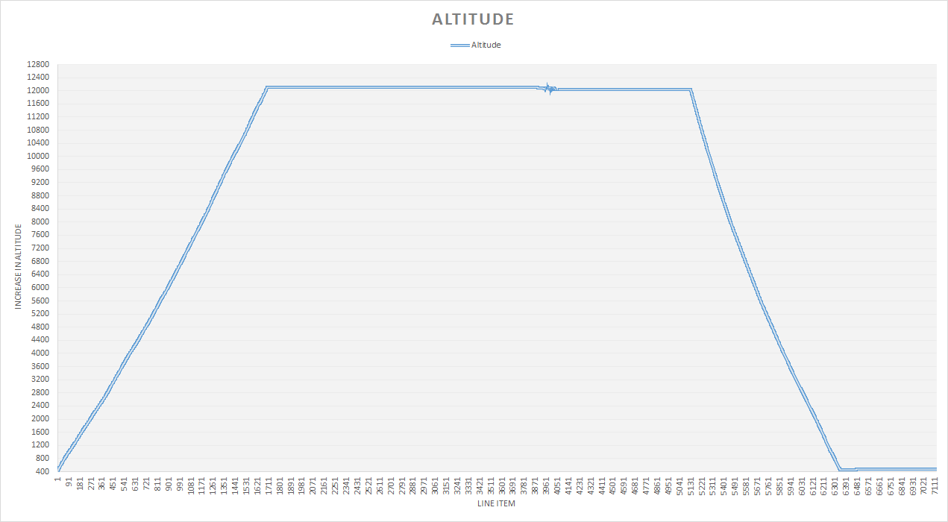

Slide 18
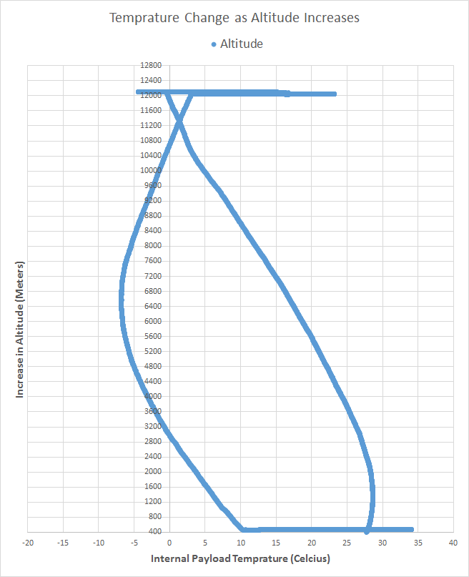

Slide 19
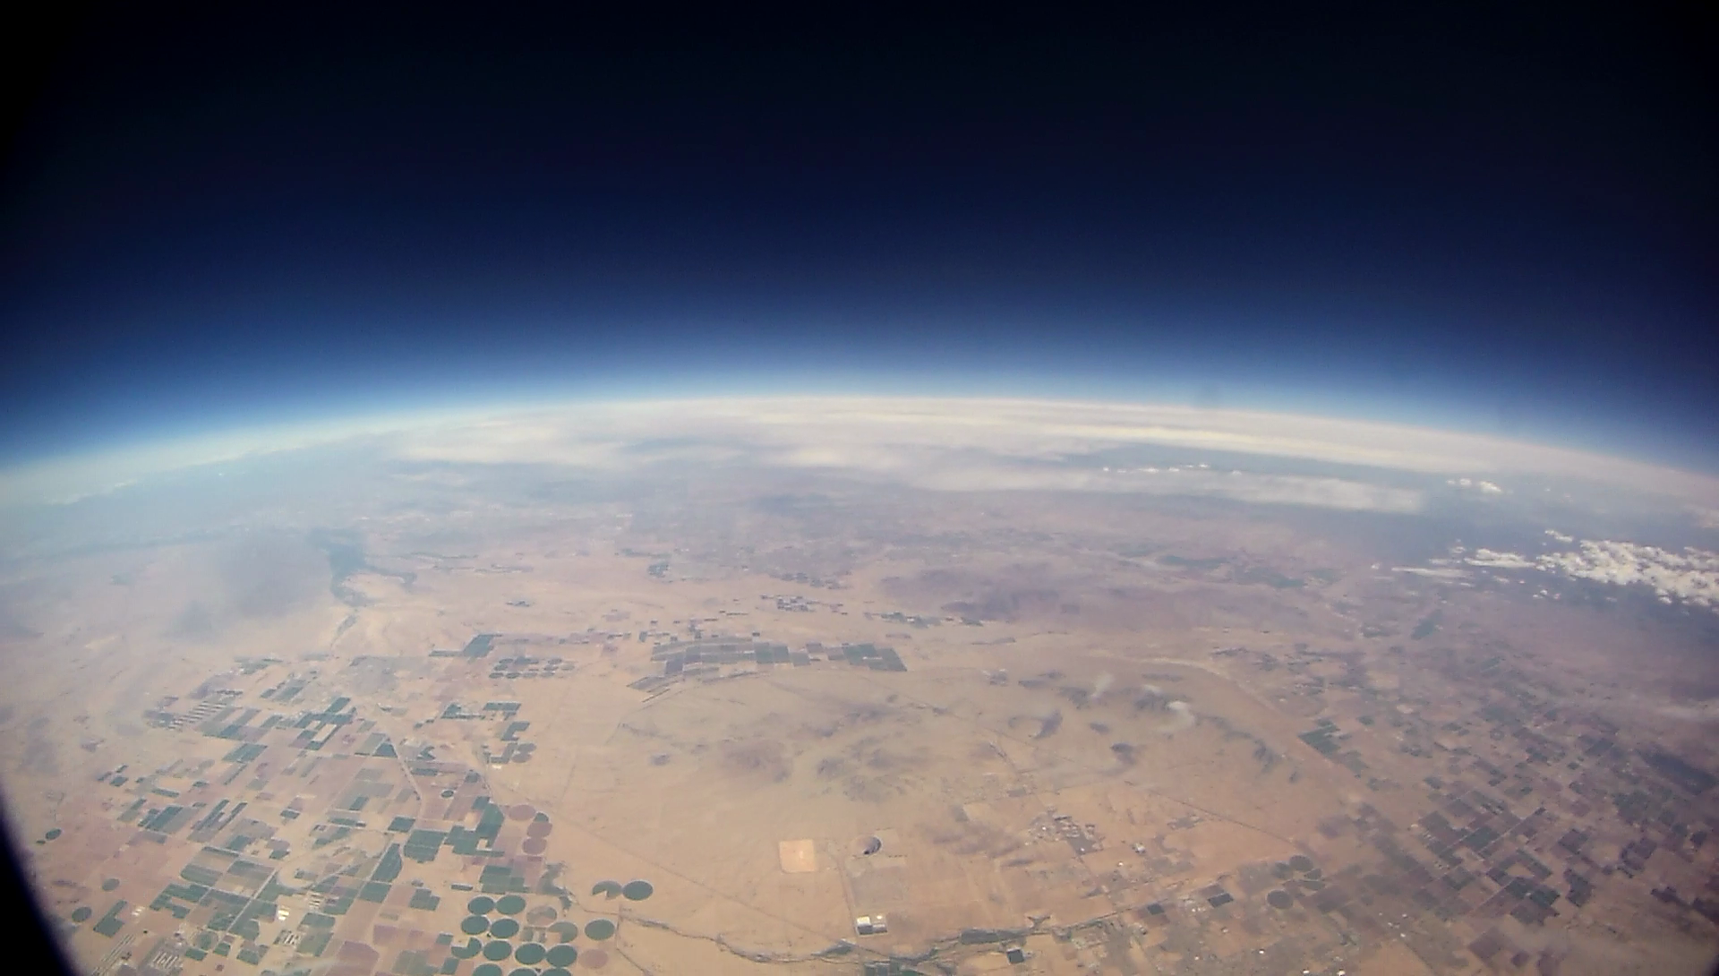
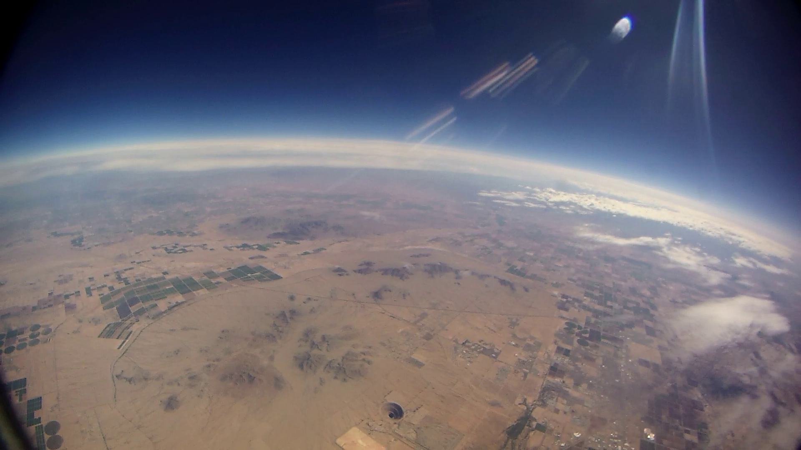
Notes:
DO NOT CHANGE HENRY

Slide 20
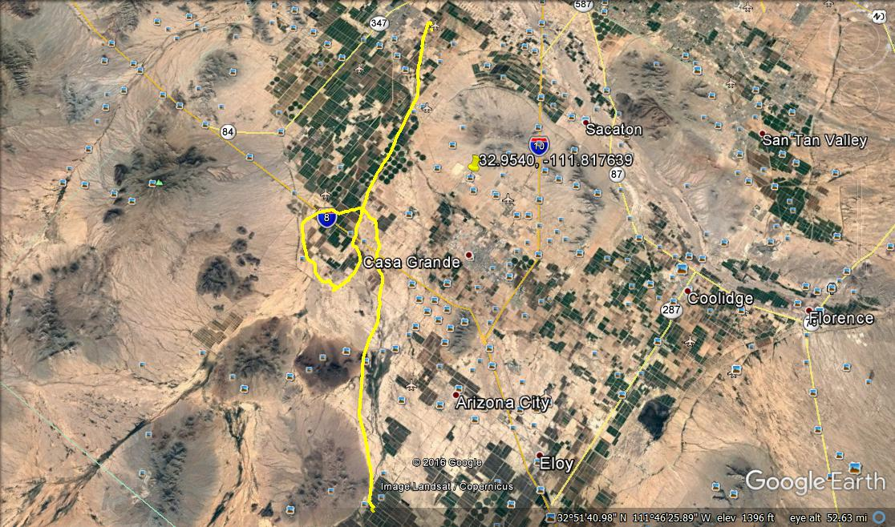

Slide 21
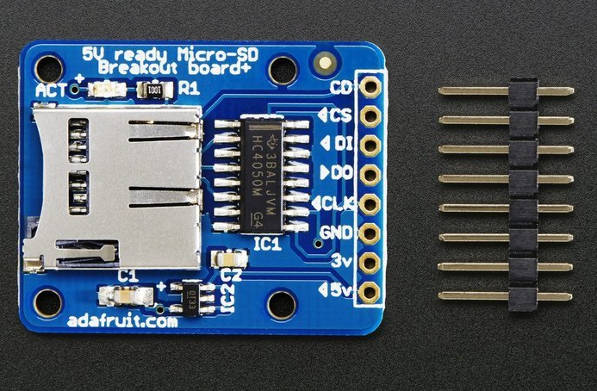
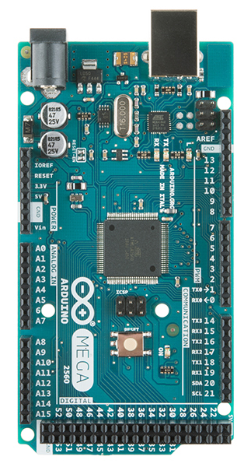

The Arduino
ATmega2560 microcontroller
Input voltage - 7-12V
54 Digital I/O Pins (14 PWM outputs)
16 Analog Inputs
256k Flash Memory
16Mhz Clock Speed
Adafruit Micro SD Card Board

Slide 22
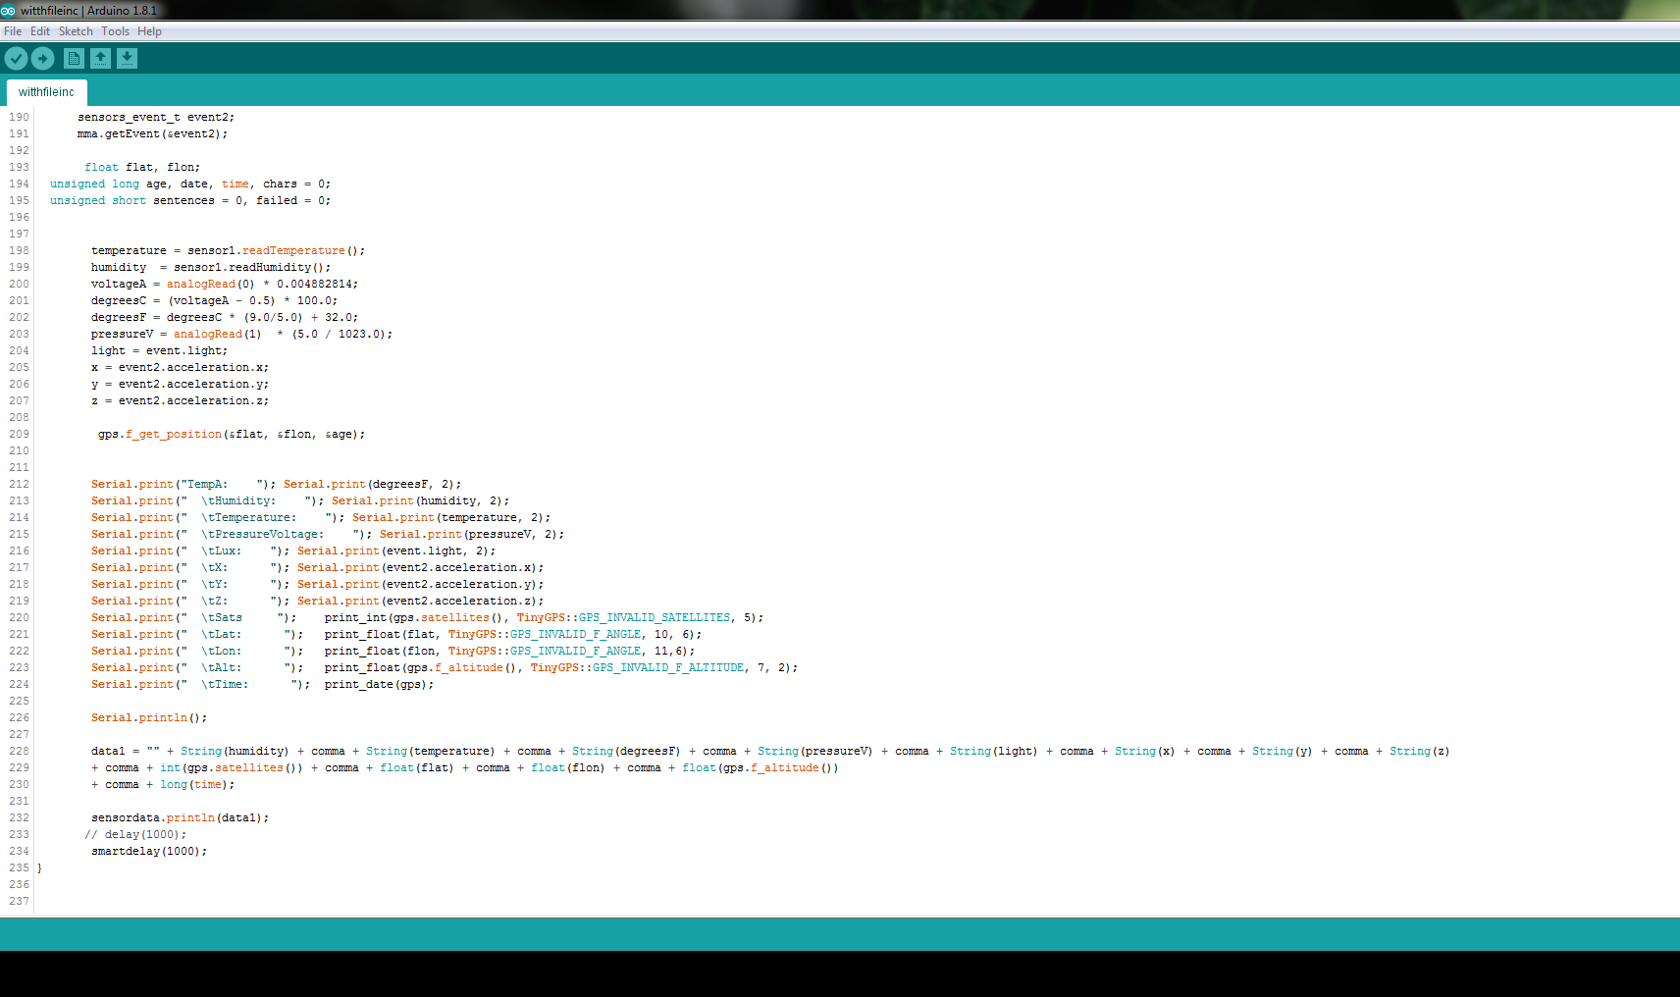
Programming the Arduino

Slide 23
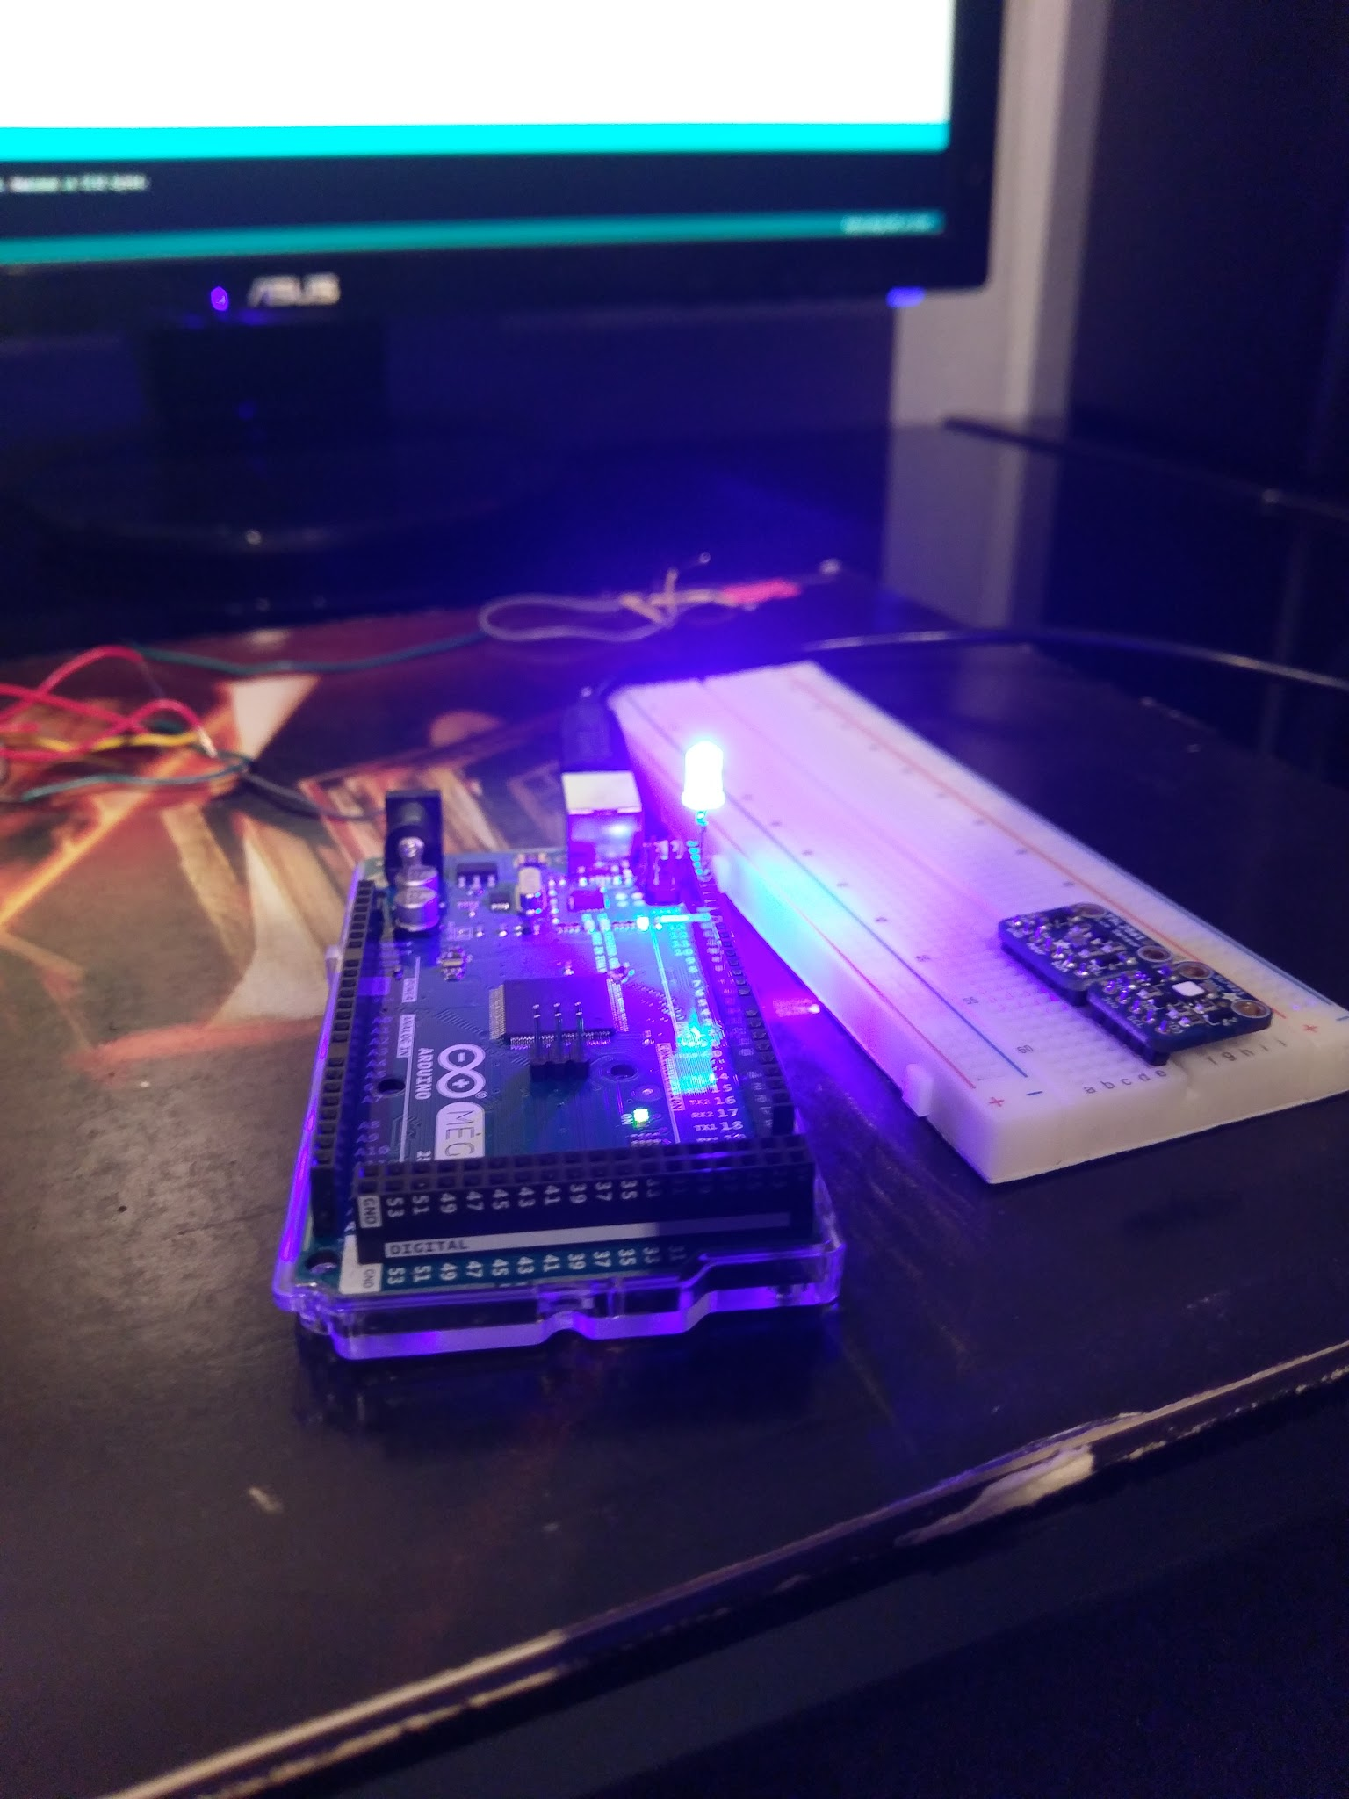
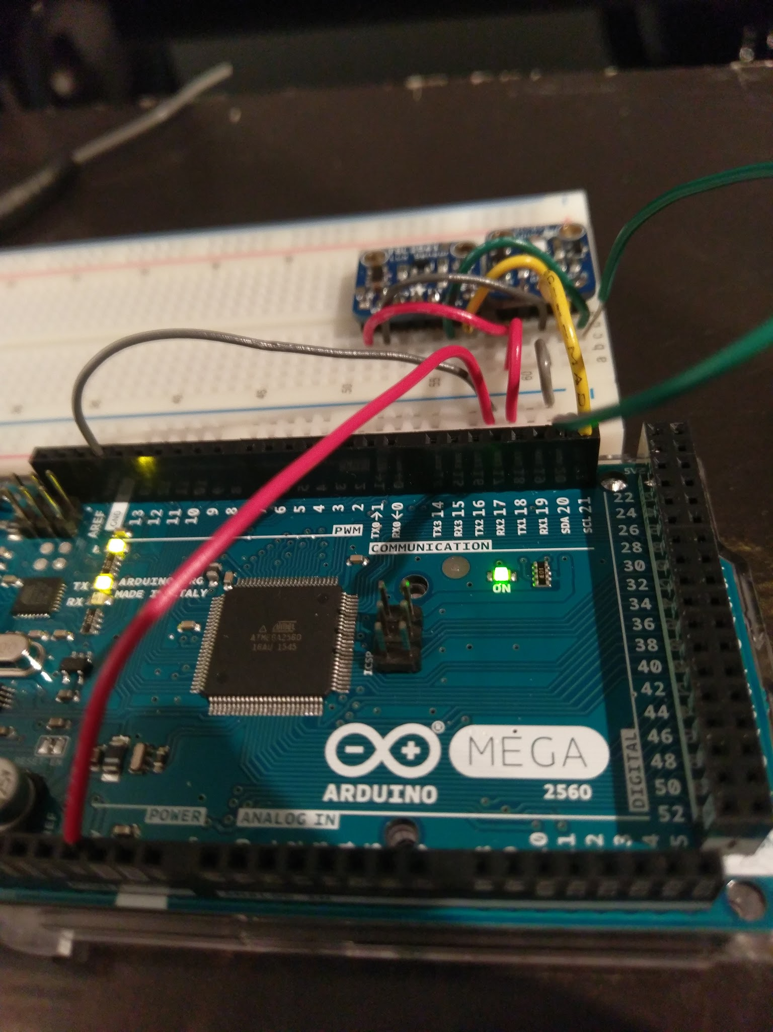

Slide 24
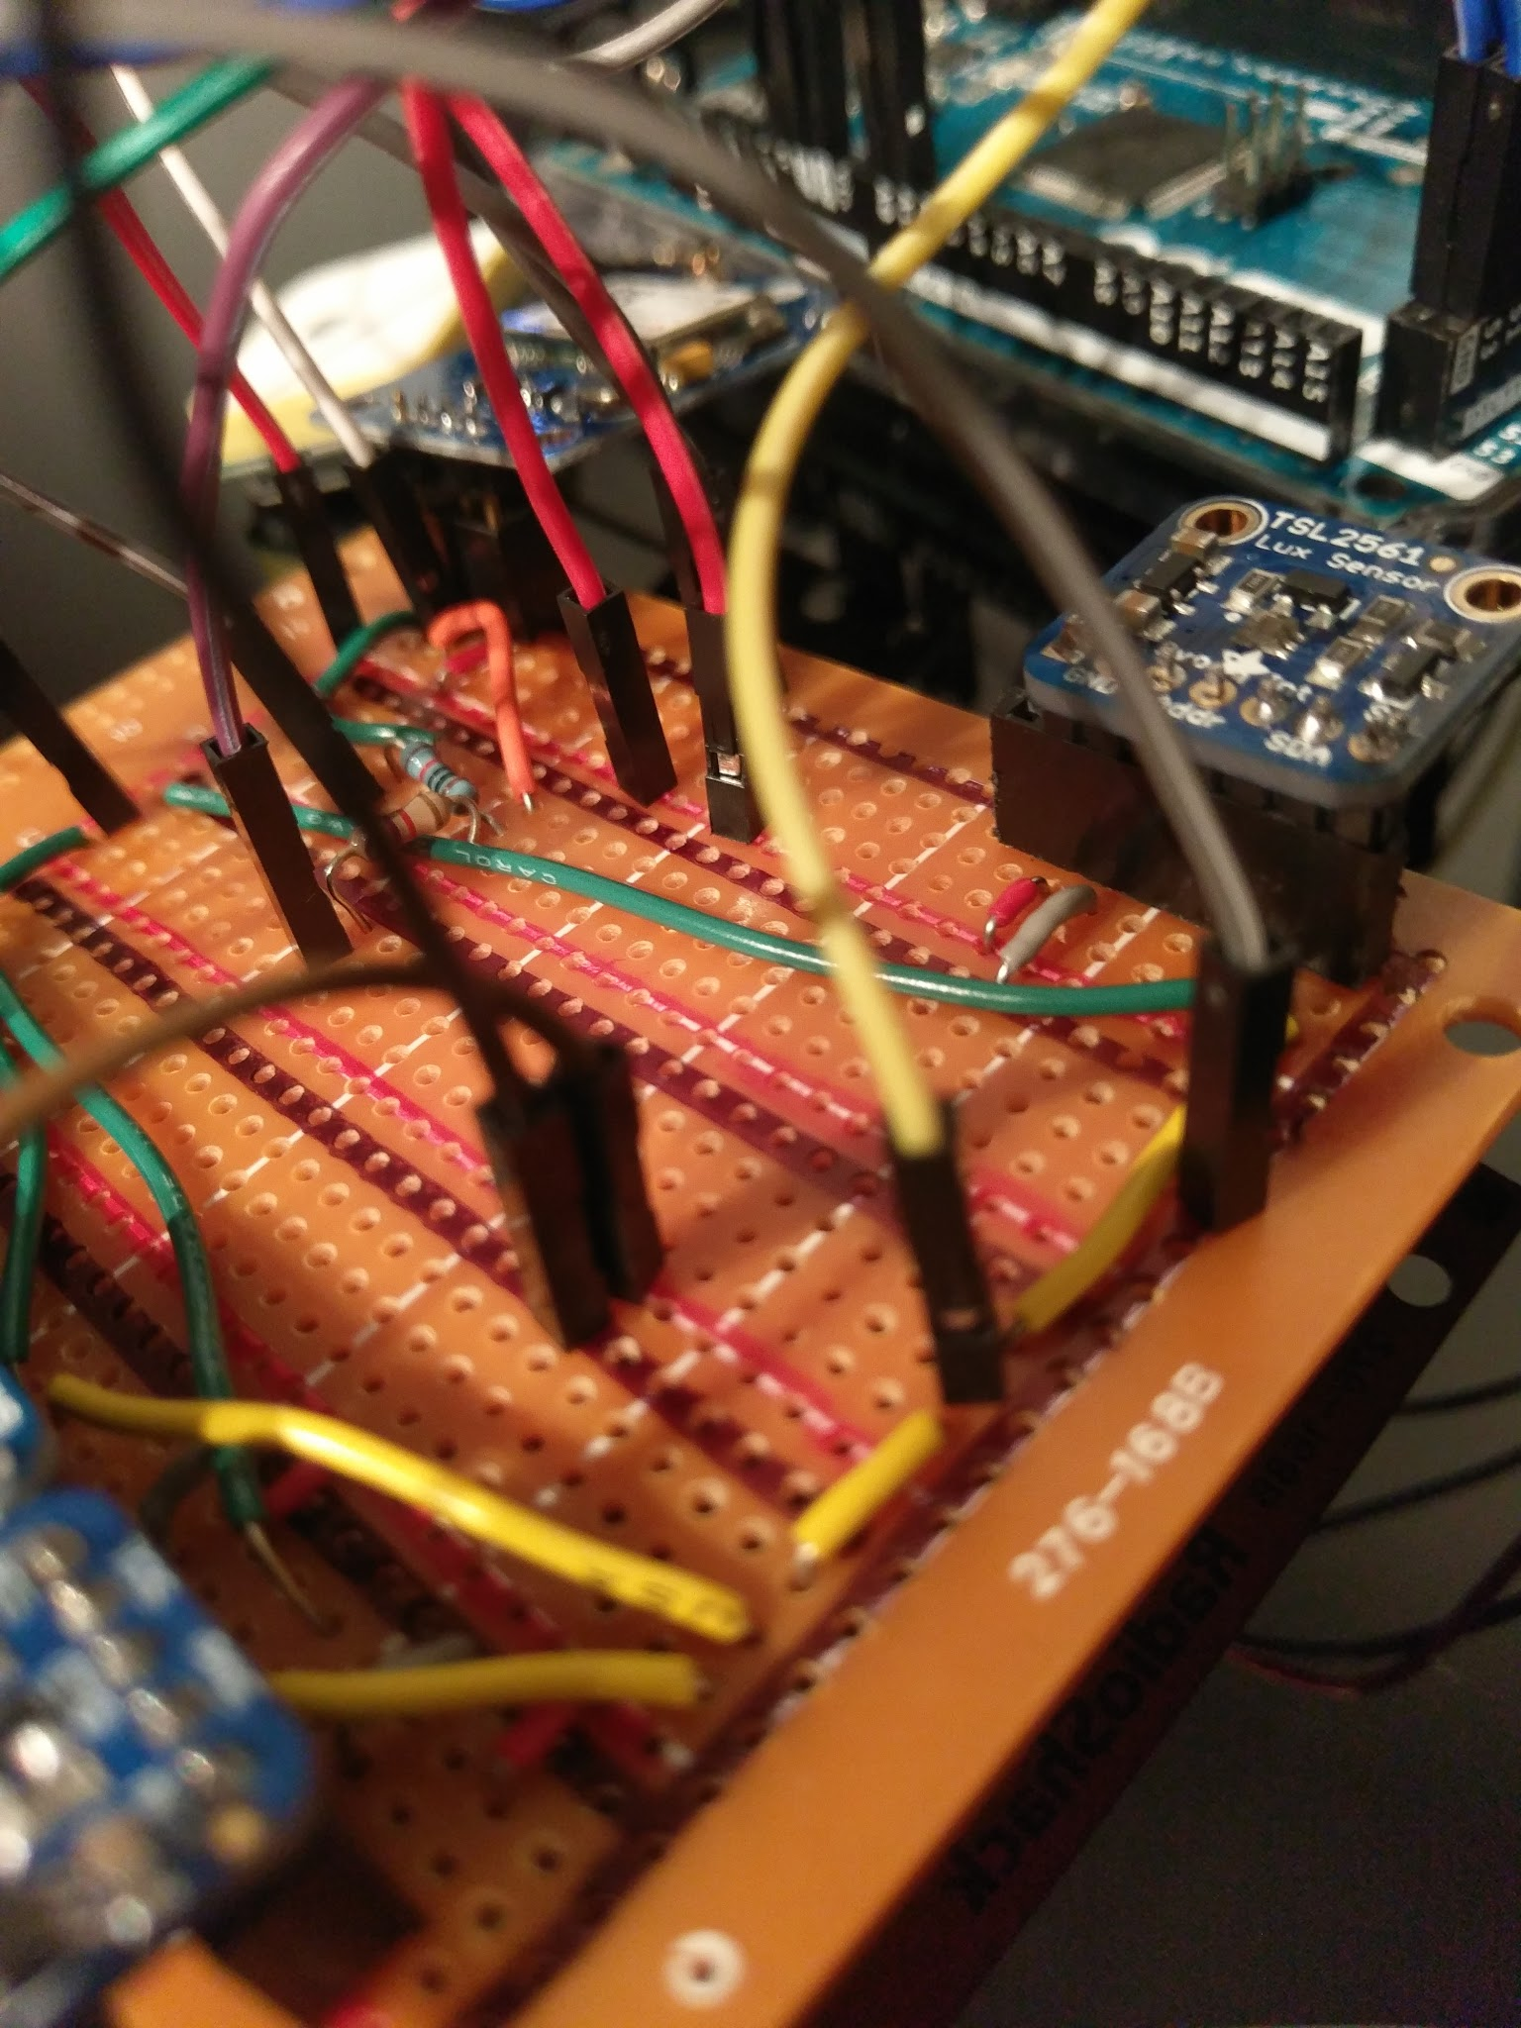
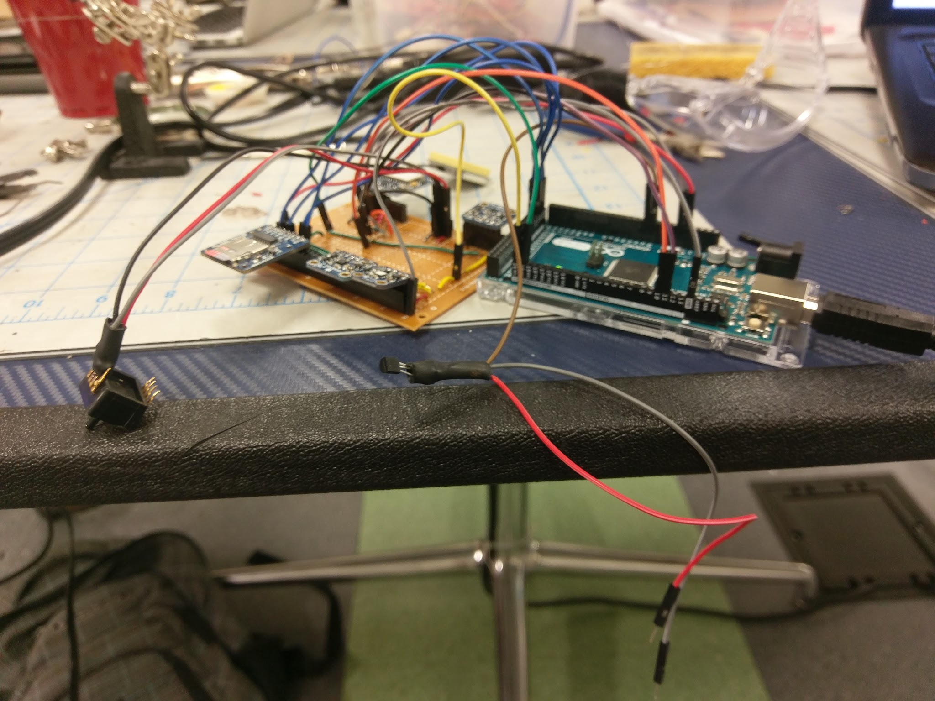
PCB Boarding

Slide 25
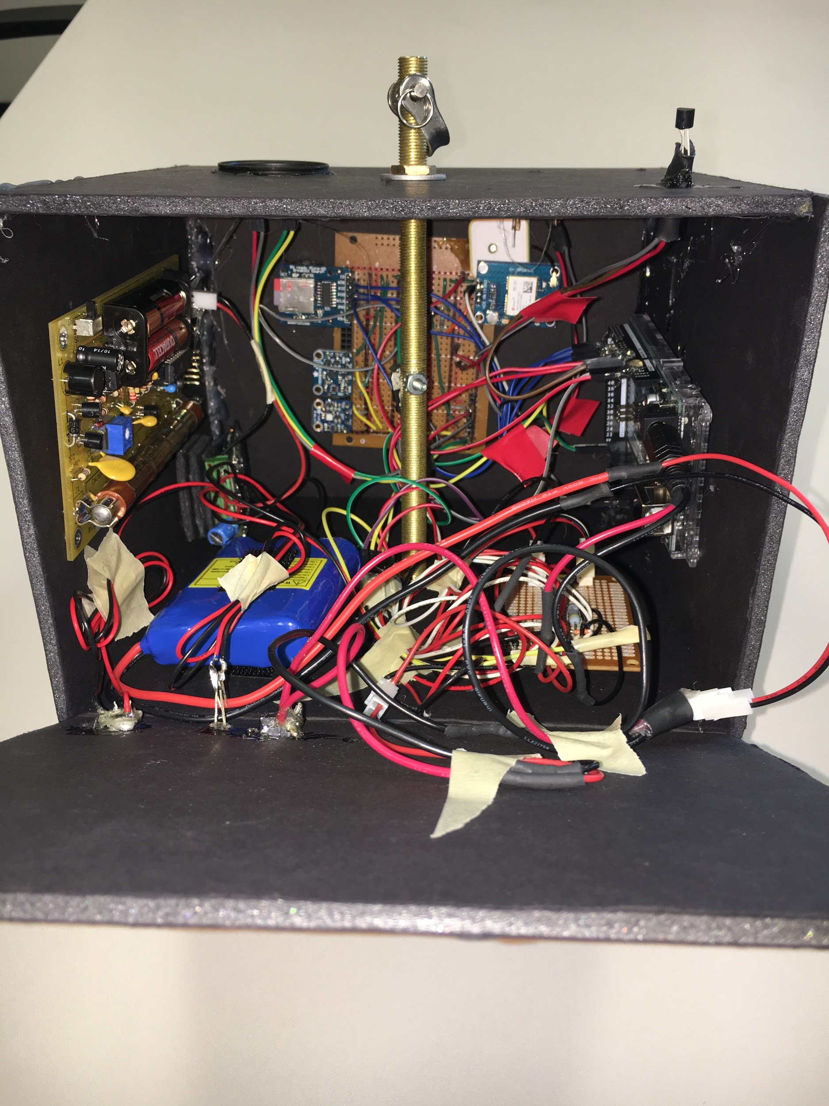
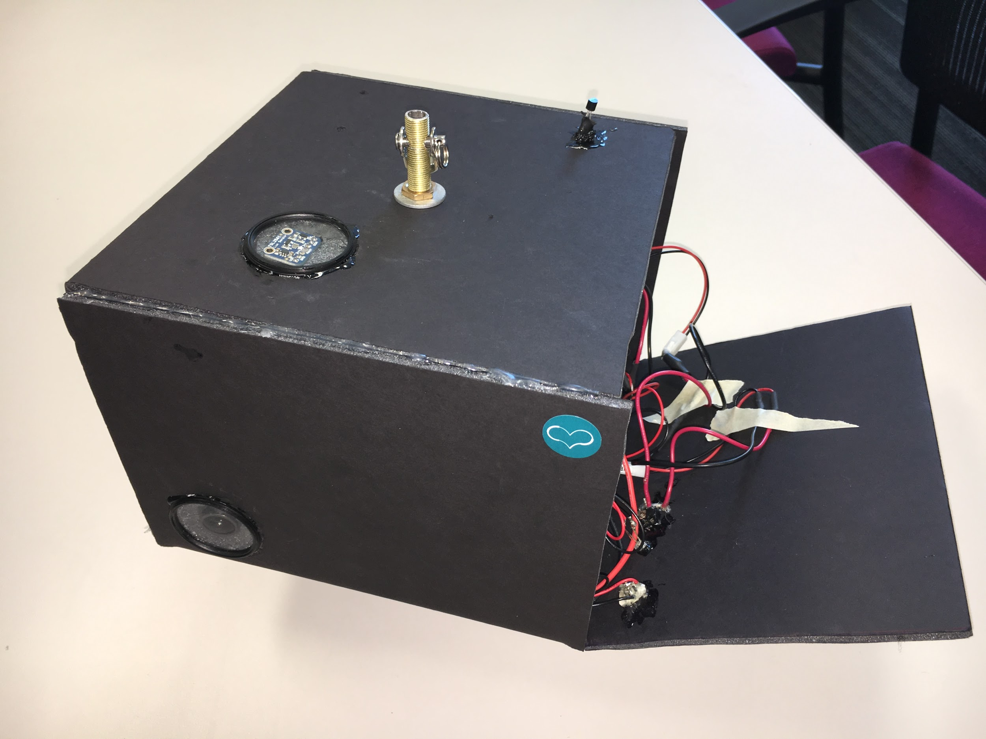
The Payload Enclosure Before Flight

Slide 26
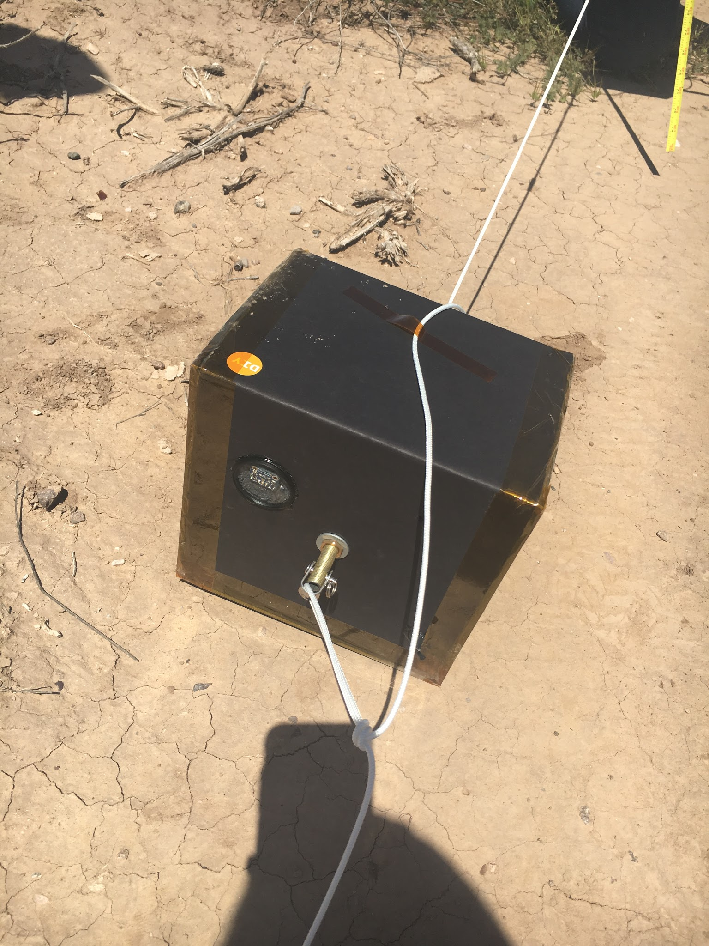
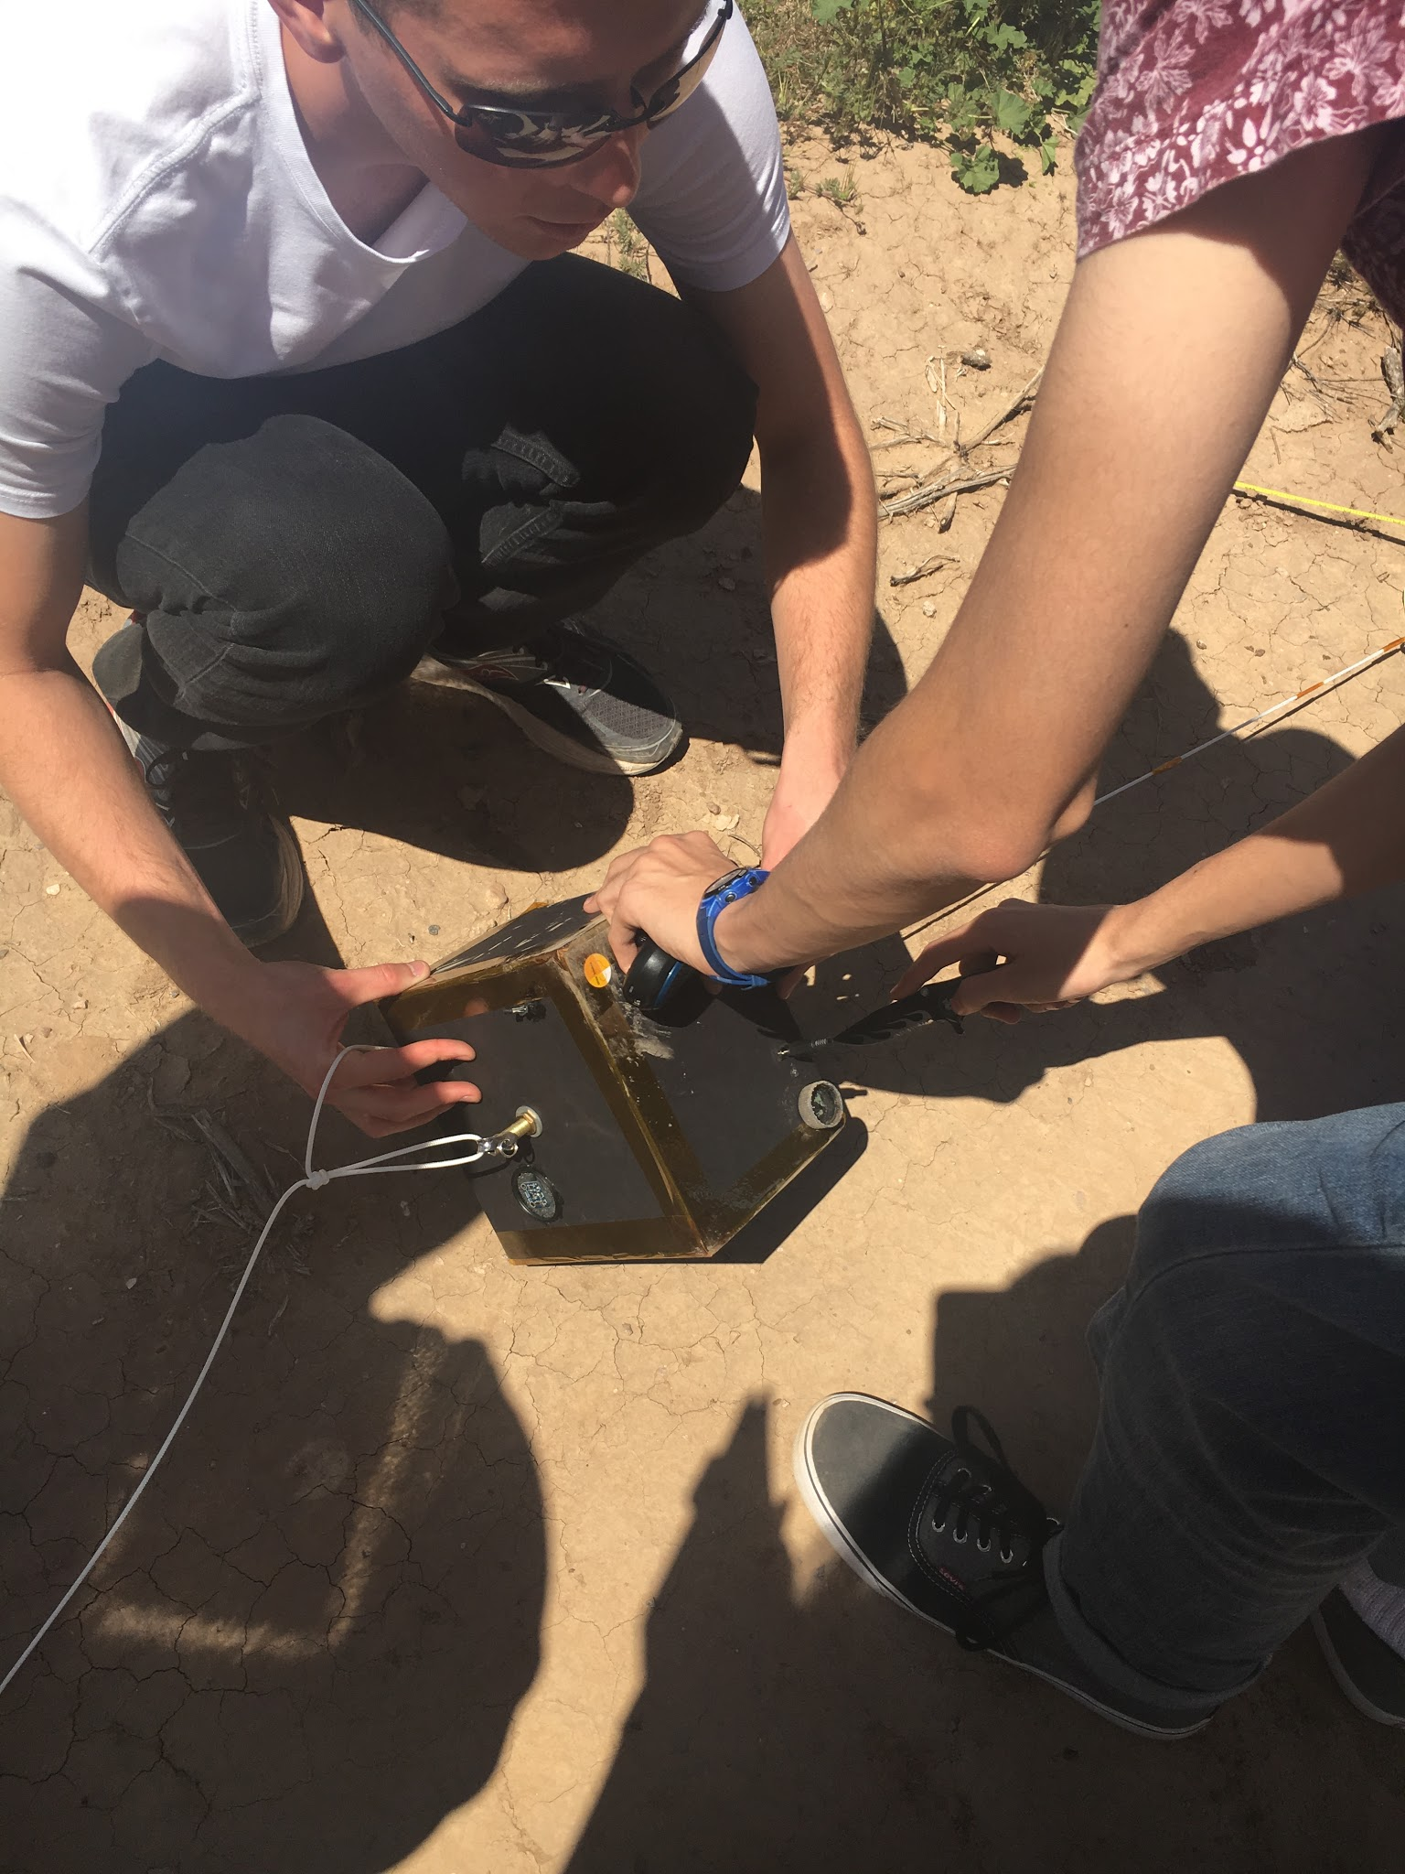
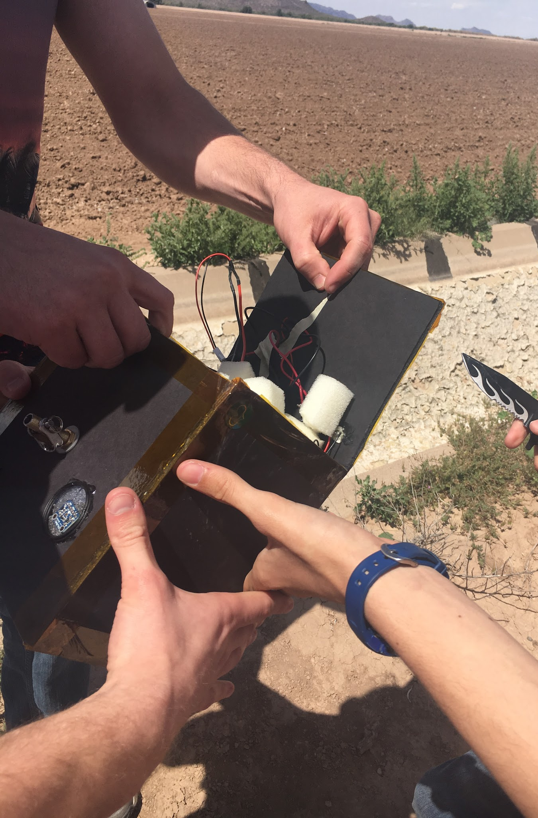
The Payload Enclosure After Flight

Slide 27

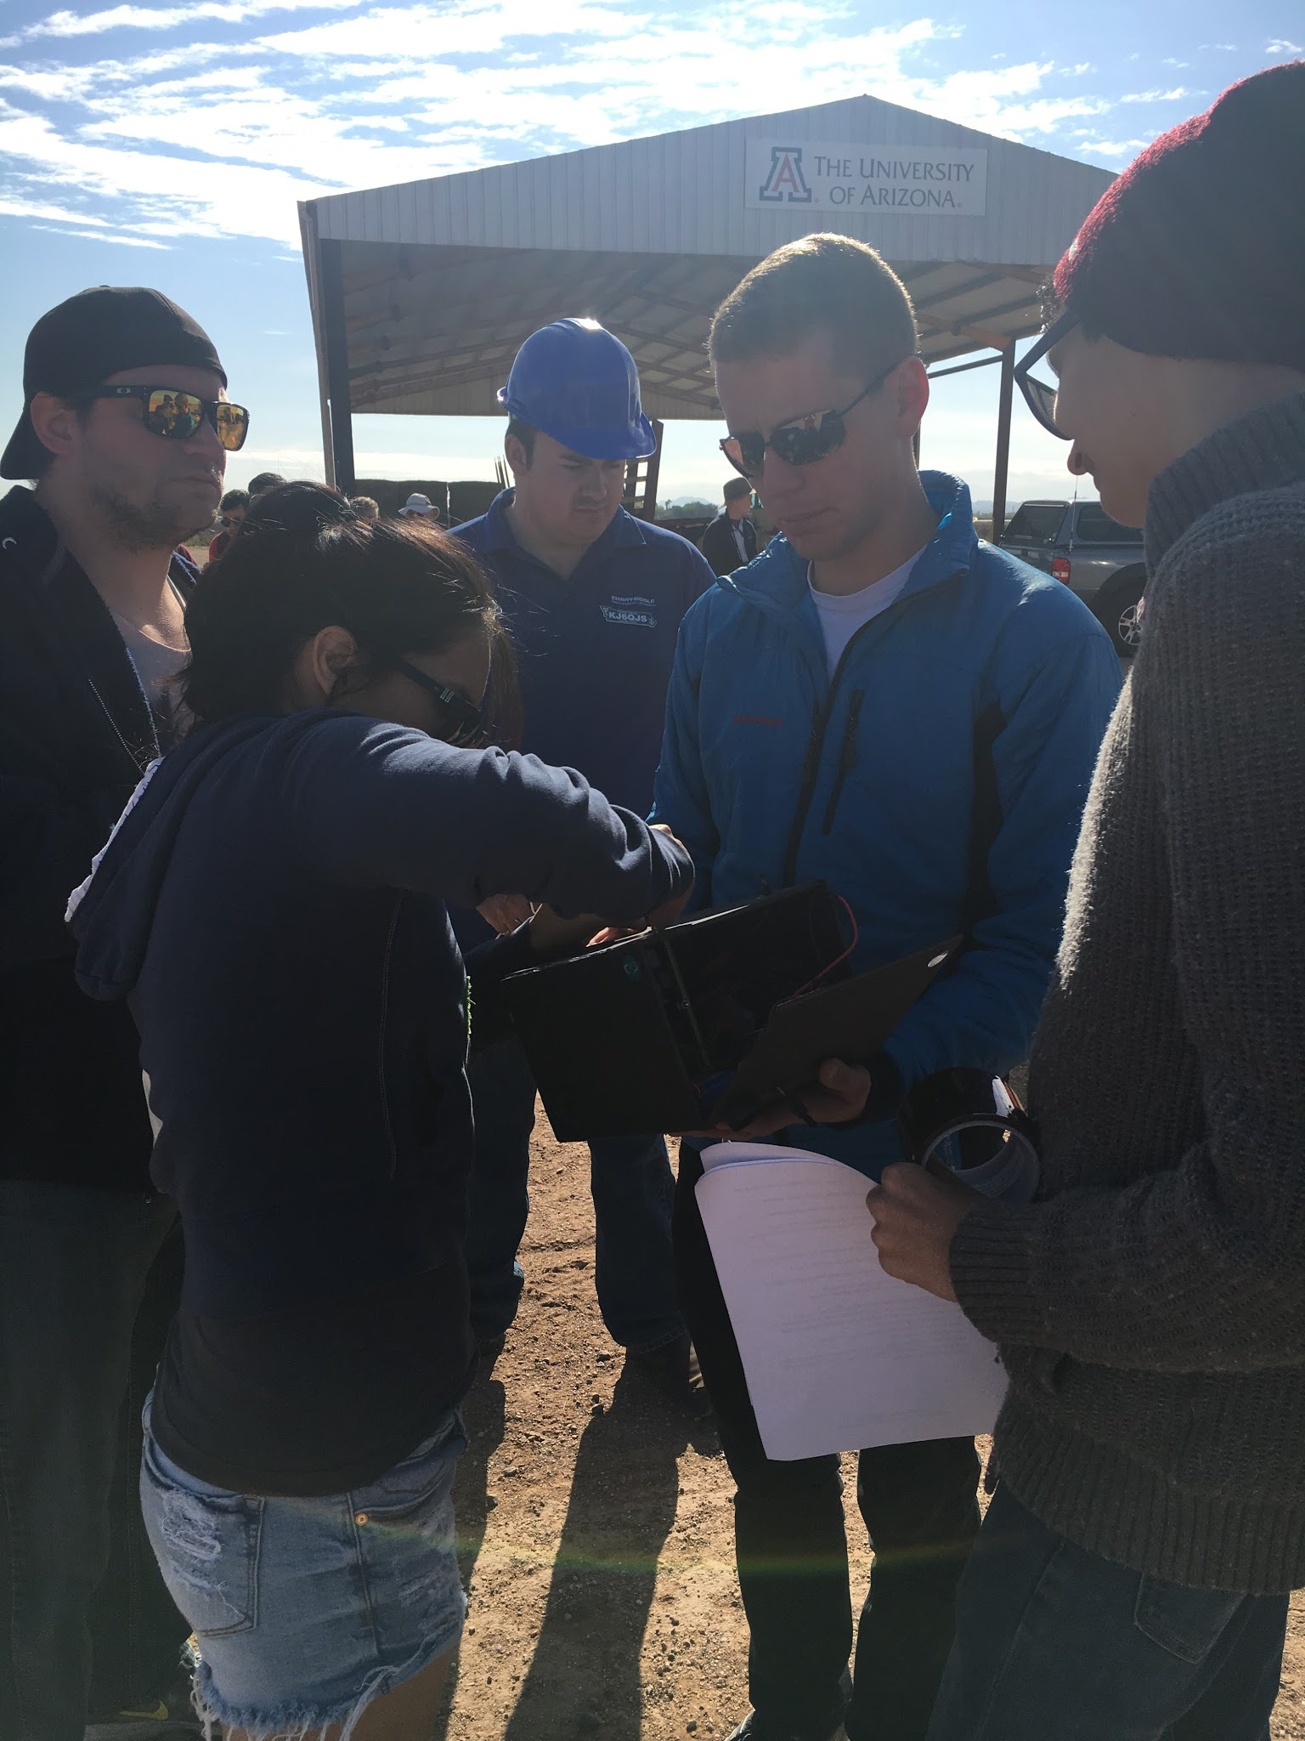
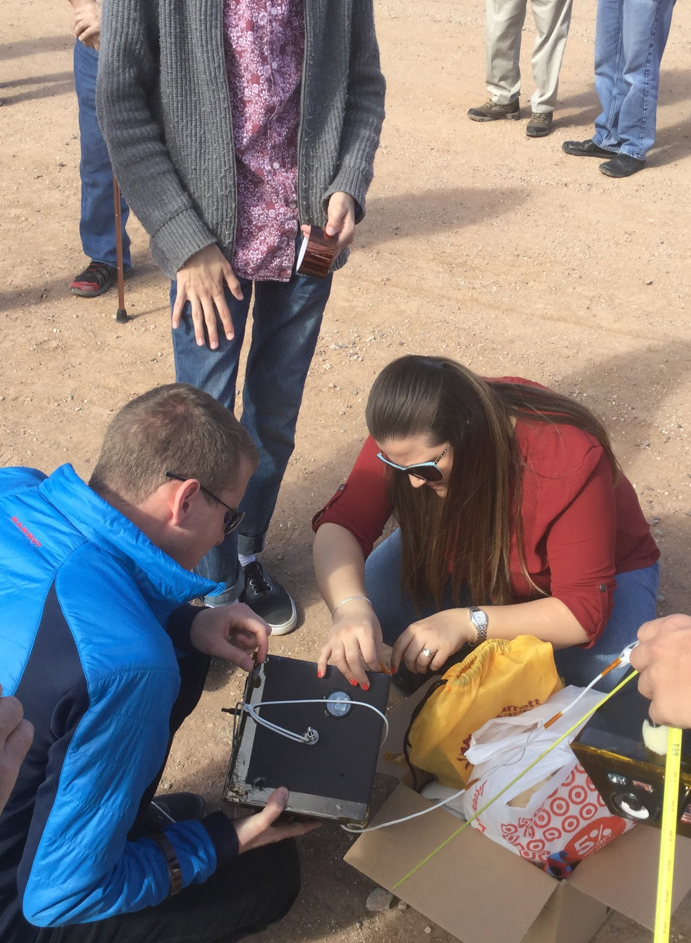
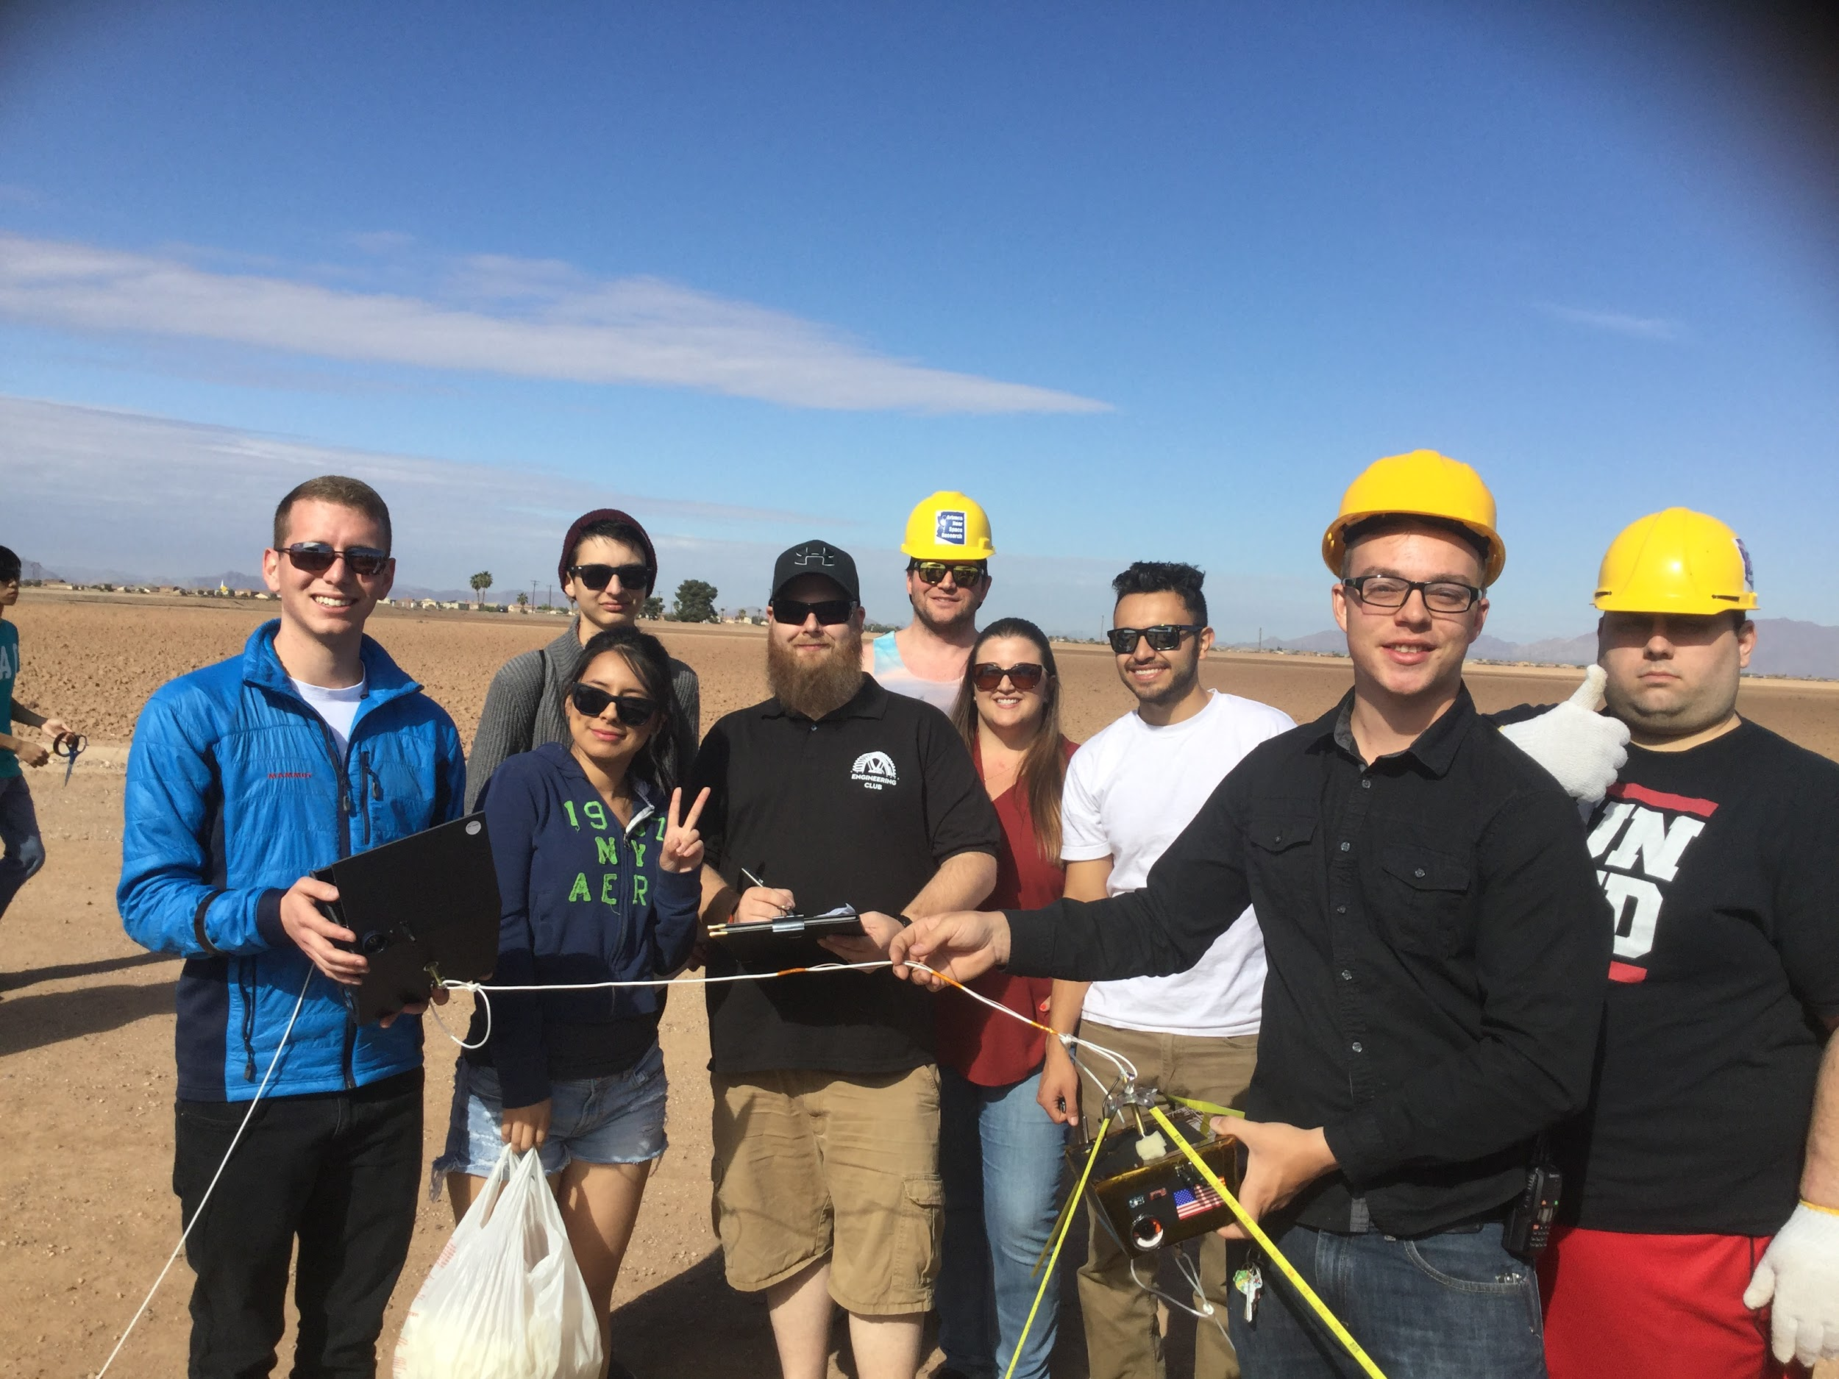
Launch
Notes:
Another Photo on click.
The Launch DO NOT CHANGE
added by Anesa, will upload photos from launch location

Slide 28
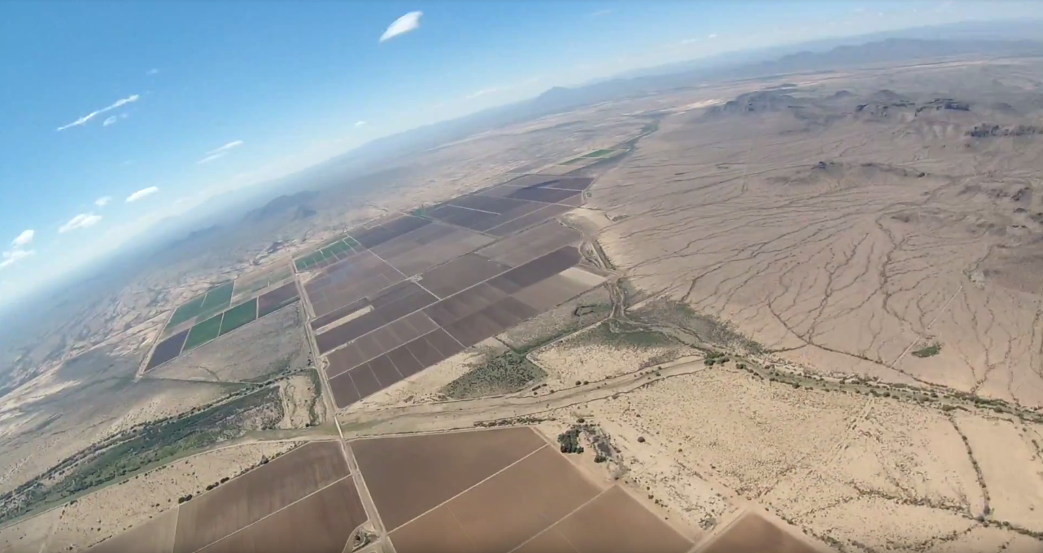
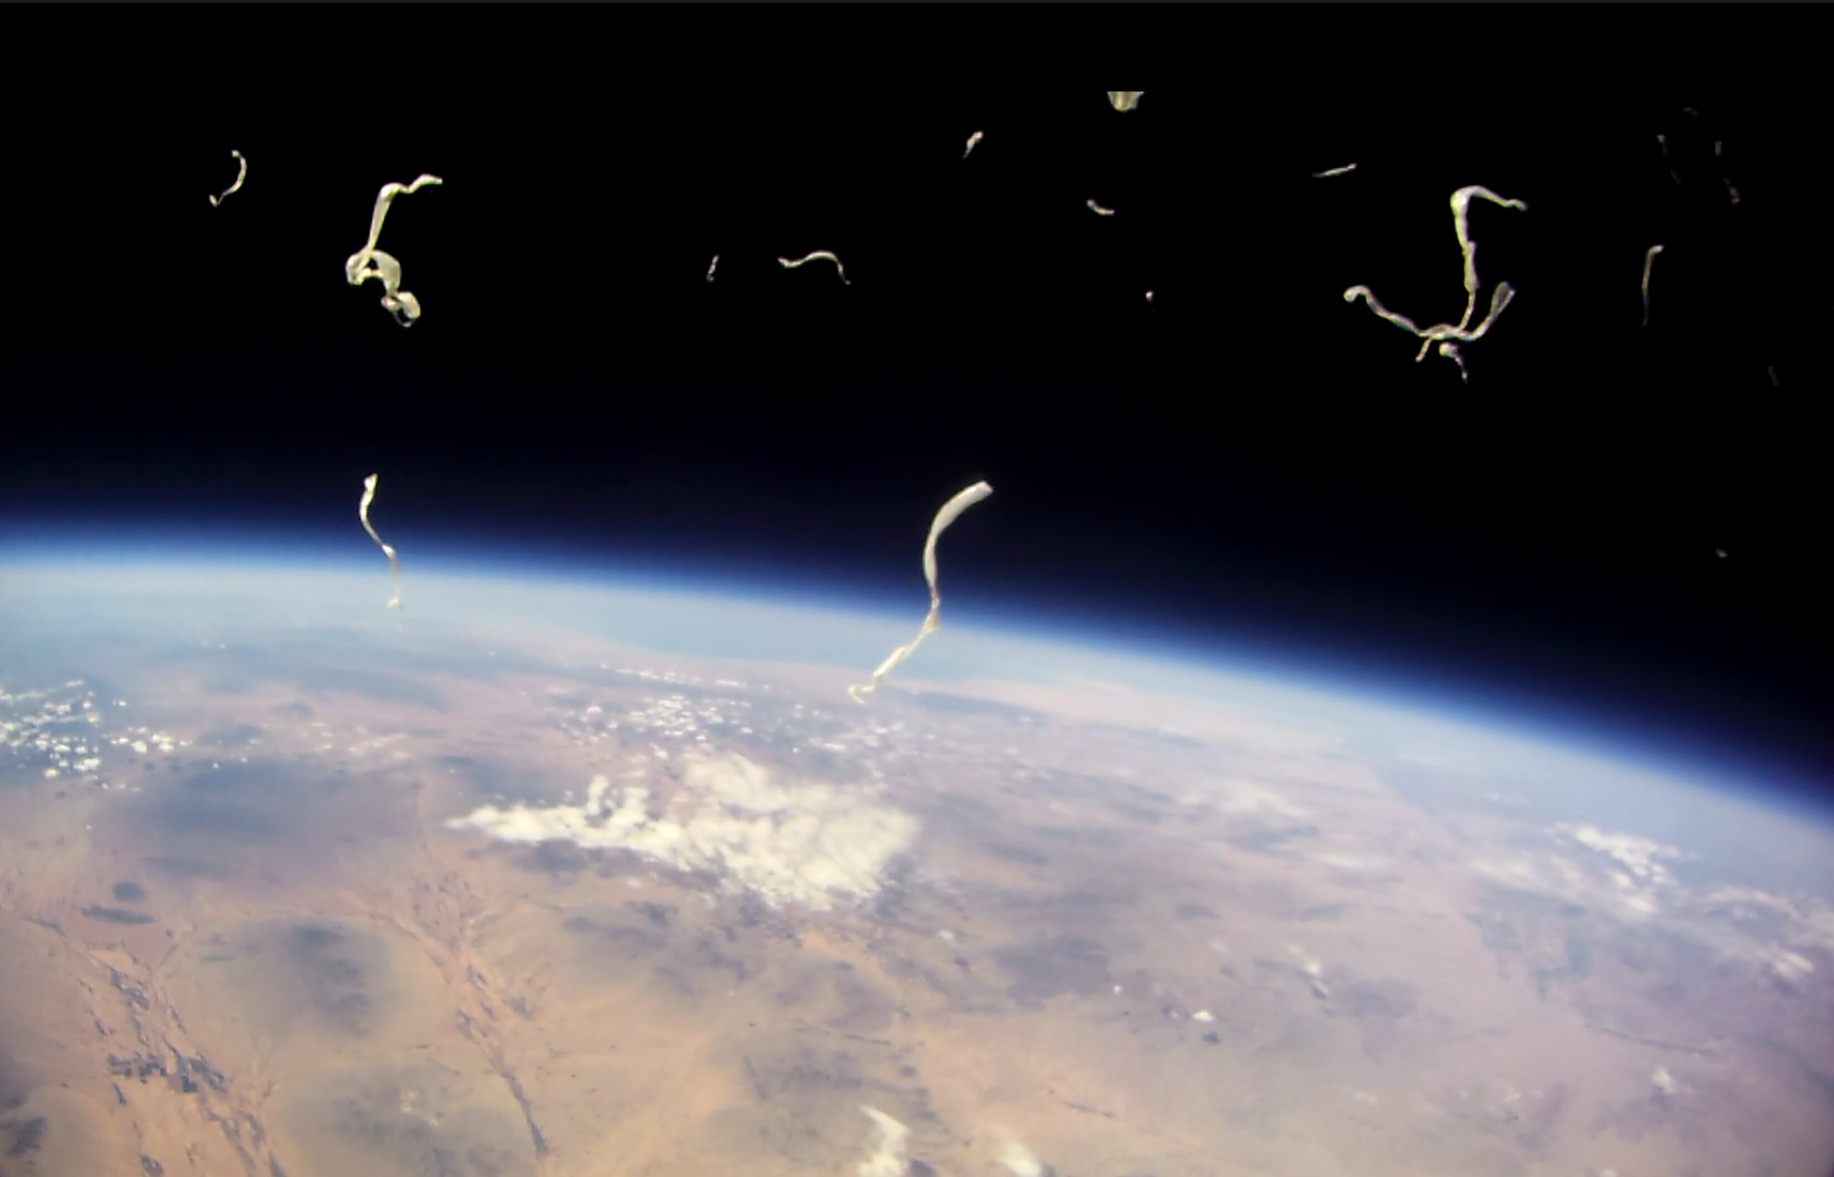
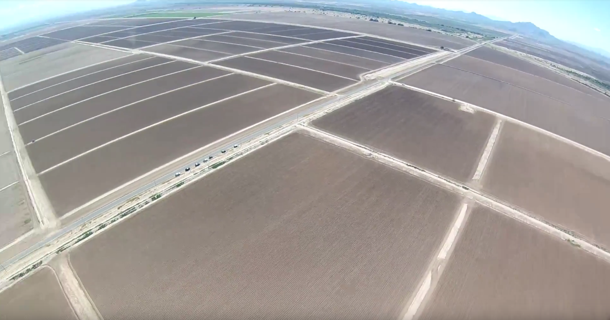
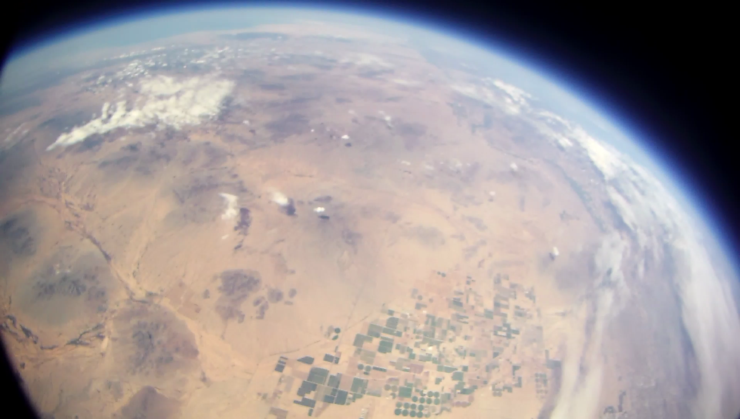
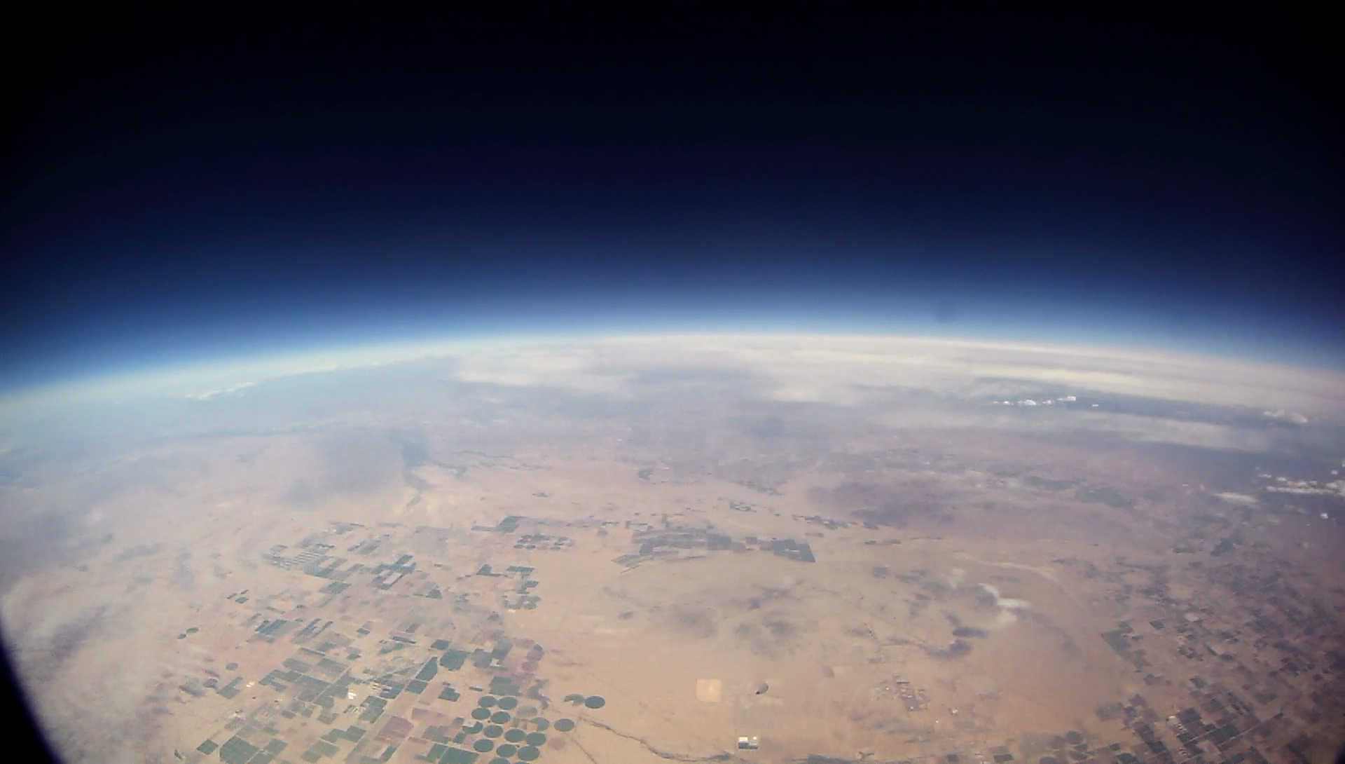

Notes:
6 photos on this slide DO NOT EVEN CLICK ON IT

Slide 29

Notes:
added by Anesa, will upload photos from launch location

Slide 30


Website (HTML/CSS)

Slide 31

For more information, visit our website.
Team2.AZEngineeringEducation.com
Notes:
To change power you can ask Nick Piacentine npiace@mars.asu.edu.

